Slide 2
Four New Names
Missions Month Week #1 Message
1 Peter 2:9-10
© March 1, 2020
Guest Speaker: Daniel Holmquist
Notes:
2

Slide 3
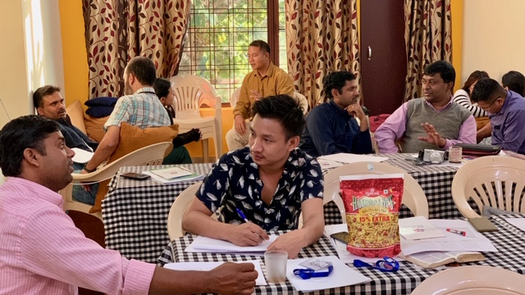

Slide 4
1 Peter 2:9-10 English Standard Version (ESV)
⁹ But you are a chosen race, a royal priesthood, a holy nation, a people for his own possession, that you may proclaim the excellencies of him who called you out of darkness into his marvelous light. ¹⁰ Once you were not a people, but now you are God's people; once you had not received mercy, but now you have received mercy.

Slide 5
All Four Names have One Purpose (v.9)
⁹ But you are a chosen race, a royal priesthood, a holy nation, a people for his own possession, that you may proclaim the excellencies of him who called you out of darkness into his marvelous light.

Slide 6
Be Ever Mindful of the New Realities (v.10)
¹⁰ Once you were not a people, but now you are God's people; once you had not received mercy, but now you have received mercy.

Slide 7
TWO PRACTICAL QUESTIONS FOR OUR EVERYDAY LIFE
How do these Four New Names (along w/their one purpose) inform your theological and missional thinking?
Which of the Four New Names, or their Purpose, or Not a People/Now a People, or Not Receive Mercy/Received Mercy affects you the most today? How?

