Slide 2
Growing Deeper in Character
A Special 2020 Vision Message on CW 12th Anniversary Sunday
Romans 5:3-5
© January 26, 2020
Pastor Paul K. Kim
Notes:
2

Slide 3
The desperate need today is not for a greater number of intelligent people, or gifted people, but for deep people. Richard J. Foster

Slide 4
CrossWay’s spiritual direction [vision] for 2020 is:
“To grow deeper in character that produces a sure hope in Christ.”
(Romans 5:3-5)

Slide 5
Romans 5:3-5 [ESV]
³ Not only that, but we rejoice in our sufferings, knowing that suffering produces endurance, ⁴ and endurance produces character, and character produces hope, ⁵ and hope does not put us to shame, because God's love has been poured into our hearts through the Holy Spirit who has been given to us.

Slide 6
SUFFERING: A BEGINNING PLACE FOR GROWING DEEPER
What are these “sufferings”?
They are present troubles ranging from minor daily annoyances to major disasters in our walk with God.
They are “pressures” to our faith in God, especially the opposition and persecution of a hostile world.

Slide 7
SUFFERING: A BEGINNING PLACE FOR GROWING DEEPER
What do these sufferings lead us to?
Jesus himself walked through the sufferings—the way of the cross.
As followers of Jesus, we are to share in his suffering as well as in his glory.
Suffering is a part of God’s plan leading us to be the co-heirs with Christ.
¹⁷ and if children, then heirs —heirs of God and fellow heirs with Christ, provided we suffer with him in order that we may also be glorified with him. ¹⁸ For I consider that the sufferings of this present time are not worth comparing with the glory that is to be revealed to us. Romans 8:17-18

Slide 8
SUFFERING: A BEGINNING PLACE FOR GROWING DEEPER
What are we to do in our sufferings?
We are NOT to pray for exemption nor escape from sufferings.
We are to GROW DEEPER through our sufferings, taking courage by faith.
³³ “I have said these things to you, that in me you may have peace. In the world you will have tribulation. But take heart; I have overcome the world.” John 16:33

Slide 9
GOD’S FOURFOLD PATHWAY TO GROWING DEEPER IN CHARACTER
PATHWAY #1: To rejoice in our sufferings (v. 3a)
³ Not only that, but we rejoice in our sufferings, knowing that suffering produces endurance, ⁴ and endurance produces character, and character produces hope, ⁵ and hope does not put us to shame, because God's love has been poured into our hearts through the Holy Spirit who has been given to us. (vs.3-5)
What does “rejoicing in our sufferings” NOT mean?
It is NOT STOICISM—acting tough like nothing happened.
It is NOT MASOCHISM—liking and enjoying pain.
It is NOT POSITIVE THINKING—keeping a positive mental attitude.
It is NOT GLORIFICATION OF SIN—rejoicing in self-inflicted pain of sins.

Slide 10
GOD’S FOURFOLD PATHWAY TO GROWING DEEPER IN CHARACTER
PATHWAY #1: To rejoice in our sufferings (v. 3a)
³ Not only that, but we rejoice in our sufferings, knowing that suffering produces endurance, ⁴ and endurance produces character, and character produces hope, ⁵ and hope does not put us to shame, because God's love has been poured into our hearts through the Holy Spirit who has been given to us. (vs.3-5)
Then, what does “rejoicing in our sufferings” really mean?
It is to respond to sufferings by FAITH in the hope in the glory of God (“this grace in which we stand, we rejoice in hope of the glory of God.” v. 2).
It is to apply the faith perspective—i.e., “KNOWING that…” (vs. 3b-5).
It is to “glory” in our sufferings—not in spite of nor in the midst of but “because of” the sufferings that God sovereignly placed in our lives.
It is to see our sufferings as a pathway of growing deeper in Christ.

Slide 11
¹¹ “Blessed are you when others revile you and persecute you and utter all kinds of evil against you falsely on my account. ¹² Rejoice and be glad, for your reward is great in heaven, for so they persecuted the prophets who were before you. Matthew 5:11-12
² Count it all joy, my brothers, when you meet trials of various kinds, ³ for you know that the testing of your faith produces steadfastness. ⁴ And let steadfastness have its full effect, that you may be perfect and complete, lacking in nothing. James 1:2-4

Slide 12
GOD’S FOURFOLD PATHWAY TO GROWING DEEPER IN CHARACTER
PATHWAY #2: To let our sufferings produce endurance in us (v. 3b)
³ Not only that, but we rejoice in our sufferings, knowing that suffering produces endurance, ⁴ and endurance produces character, and character produces hope, ⁵ and hope does not put us to shame, because God's love has been poured into our hearts through the Holy Spirit who has been given to us. (vs.3-5)
Sufferings are trials in which our faith is being tested—some may come out as shallow pseudo-faith and some as deep real faith.
This very process of testing produces consistent persevering faith in us if it is a true real faith; this is why suffering produces endurance.
In our sufferings, it is not us trying to hold onto God, but it is actually God’s sustaining grace on us—i.e., God’s grip on us is stronger than any trials!

Slide 13
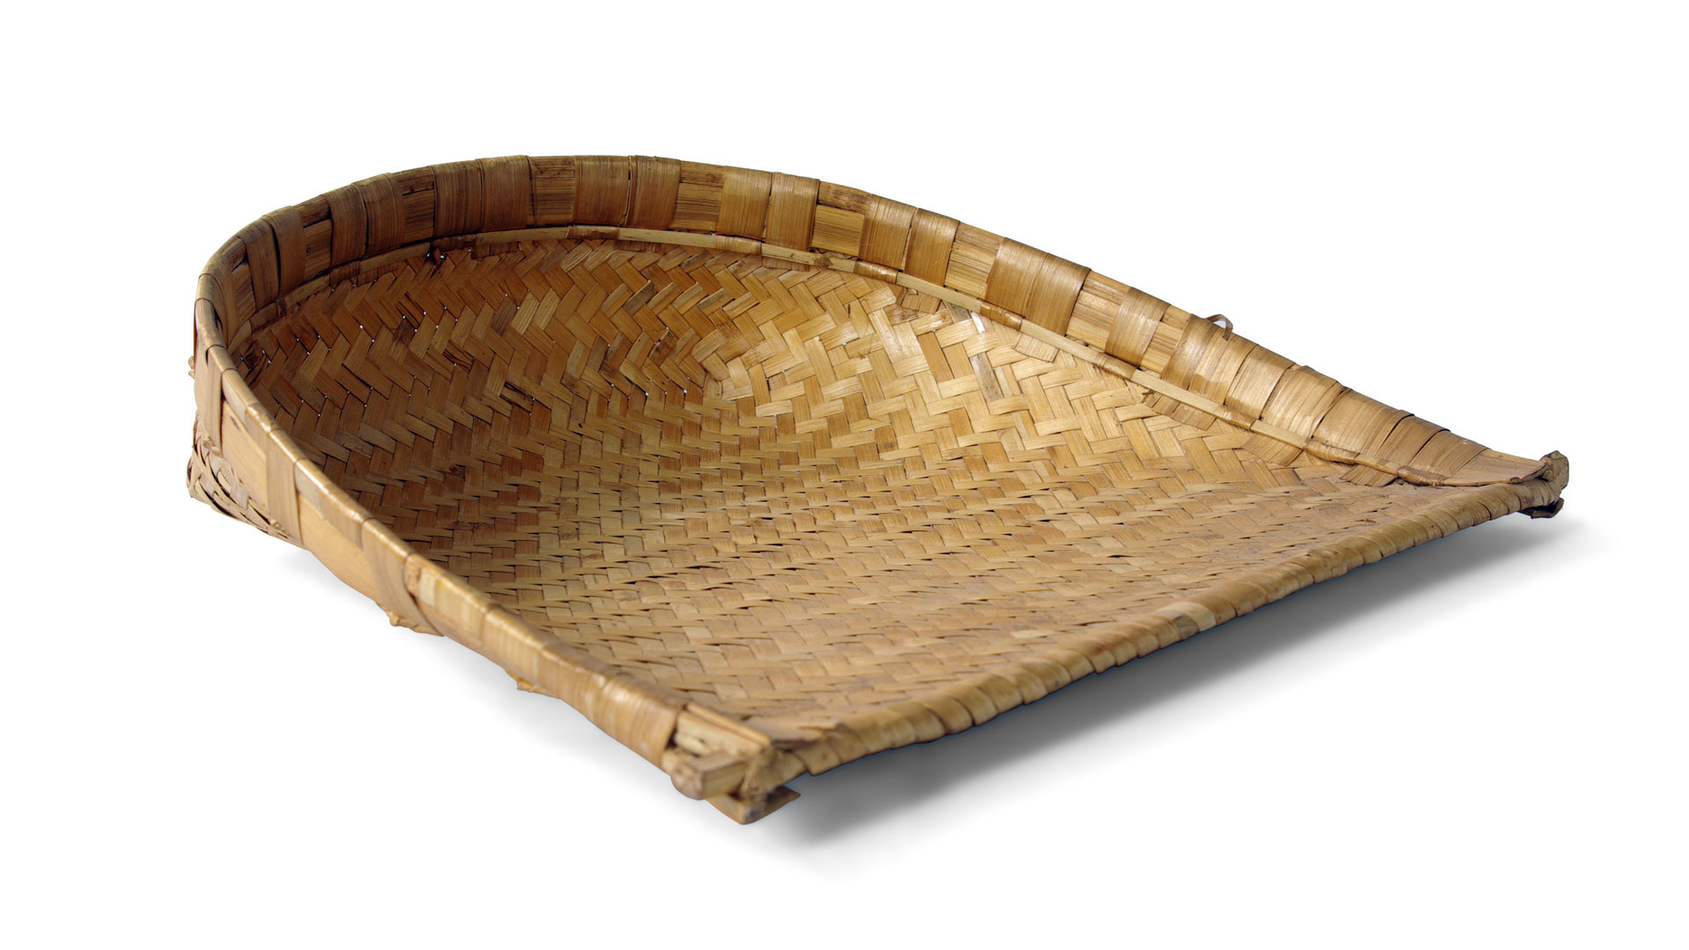
⁶⁷ Before I was afflicted I went astray, but now I keep your word . . . ⁷¹ It is good for me that I was afflicted, that I might learn your statutes. Psalm 119:67, 71

Slide 14
GOD’S FOURFOLD PATHWAY TO GROWING DEEPER IN CHARACTER
PATHWAY #3: To let our endurance produce proven character in us (v. 4a)
³ Not only that, but we rejoice in our sufferings, knowing that suffering produces endurance, ⁴ and endurance produces character, and character produces hope, ⁵ and hope does not put us to shame, because God's love has been poured into our hearts through the Holy Spirit who has been given to us. (vs.3-5)
As we endure our sufferings, the constant perseverance results in the proof that our faith is real—deep and sustainable in storms of trials.
This is what happens to us on the pathway of endurance designed by God—that our character gets deepened in faith with integrity and strength.
Like steels get tested and strengthened through a furnace of fire and cooling process, our faith character gets strengthened and transformed into Christ’s image!

Slide 15
⁶ In this you rejoice, though now for a little while, if necessary, you have been grieved by various trials, ⁷ so that the tested genuineness of your faith—more precious than gold that perishes though it is tested by fire—may be found to result in praise and glory and honor at the revelation of Jesus Christ. ⁸ Though you have not seen him, you love him. Though you do not now see him, you believe in him and rejoice with joy that is inexpressible and filled with glory, ⁹ obtaining the outcome of your faith, the salvation of your souls. 1 Peter 1:6-9

Slide 16
GOD’S FOURFOLD PATHWAY TO GROWING DEEPER IN CHARACTER
PATHWAY #4: To let our character produce hope in Christ with God’s love poured out into our hearts (v. 4b-5)
³ Not only that, but we rejoice in our sufferings, knowing that suffering produces endurance, ⁴ and endurance produces character, and character produces hope, ⁵ and hope does not put us to shame, because God's love has been poured into our hearts through the Holy Spirit who has been given to us. (vs.3-5)
The last pathway is back to hope (v. 2) but this time the hope is reassured with the certainty of God’s love poured out into us through the Spirit.
This is a personal experience of assurance of God’s love, therefore this hope becomes the anchor of our souls in this life and in eternity.
The reassured hope is cultivated in the overflowing love of God in our heats in such a powerful undeniable way!

Slide 17
In times of affliction we commonly meet with the sweetest experiences of the love of God. John Bunyan

Slide 18
He Giveth More Grace
by Annie Johnson Flint (1866-1932)
He giveth more grace when the burdens grow greater,
He sendeth more strength when the labors increase;
To added afflictions He addeth His mercy,
To multiplied trials, His multiplied peace.
When we have exhausted our store of endurance,
When our strength has failed, 'ere the day is half done,
When we reach the end of our hoarded resources,
Our Father's full giving is only begun.
His love has no limit, His grace has no measure;
His power no boundary known unto men.
For out of His infinite riches in Jesus,
He giveth, and giveth, and giveth again.

Slide 19
“GROWING DEEPER IN CHARACTER”: OUR VISION FOR 2020
In the year 2020, let’s envision us to be a church [Christ-followers] that . . .
Rejoice in our sufferings, knowing that God’s purpose is good for us.
Let our sufferings produce endurance in us, trusting that God’s grace would sustain us in our sufferings.
Let our endurance produce proven character in us, trusting that God’s testing would refine us toward Christlikeness.
Let our character produce hope in Christ, trusting that God’s poured-out love would anchor us in the reassured hope in Christ.
By faith, let’s strive for deeper growth in our character and faith this new year so God would be glorified in and through CrossWay Church!

Slide 20
THREE PRACTICAL QUESTIONS FOR OUR EVERYDAY LIFE
In what ways are you now more convinced of your need for growing deeper in character in this new year?
What would it mean for you to rejoice in your sufferings by faith?
What will be your first step in experiencing God’s fourfold way for you to deeper this year—(1) rejoicing sufferings, (2) bearing endurance, (3) deepening character, and (4) strengthening hope?

