Slide 2
The Good News of Christmas
A Special Christmas Sunday Message
Luke 2:10-11
© December 22, 2019
Pastor Paul K. Kim
Notes:
2

Slide 3
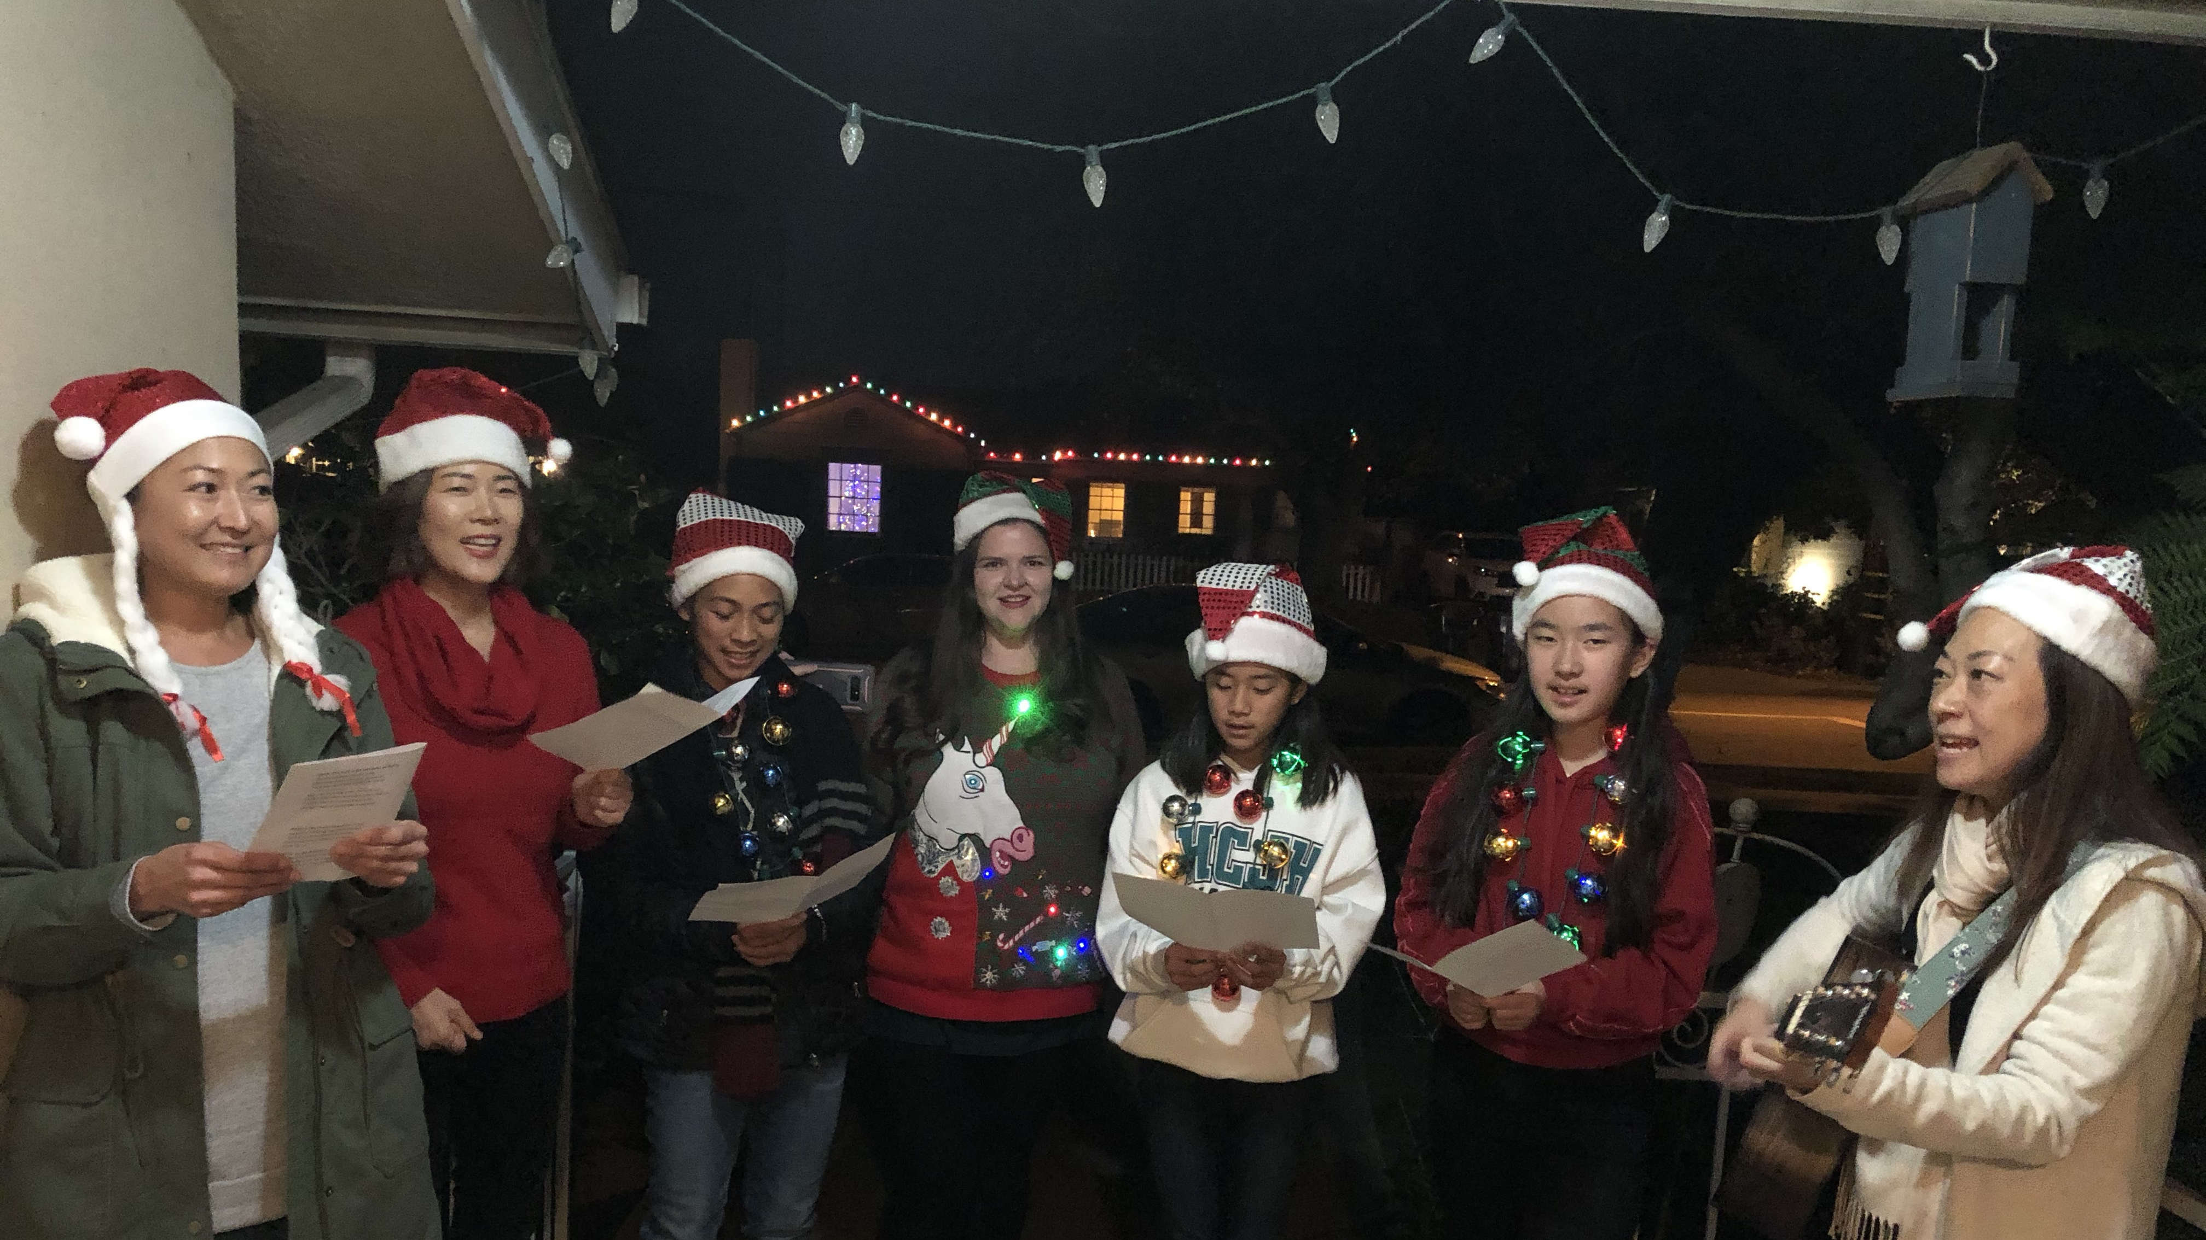

Slide 4
WHAT IS THE GOOD NEWS OF CHRISTMAS?
¹⁰ And the angel said to them, “Fear not, for behold, I bring you good news of great joy that will be for all the people. ¹¹ For unto you is born this day in the city of David a Savior, who is Christ the Lord.” Luke 2:10-11

Slide 5
WHAT IS THE GOOD NEWS OF CHRISTMAS?
¹⁰ And the angel said to them, “Fear not, for behold, I bring you good news of great joy that will be for all the people. ¹¹ For unto you is born this day in the city of David a Savior, who is Christ the Lord.” Luke 2:10-11
That Jesus is born to be the SAVIOR of all sinners (Rom. 5:8).
That Jesus who is born is the CHRIST—the promised Messiah (John 3:16).
That Jesus who is born is the LORD of all (Phil. 2:11; Isa. 9:6).

Slide 6
⁶ For to us a child is born,
to us a son is given;
and the government shall be upon his shoulder,
and his name shall be called
Wonderful Counselor, Mighty God,
Everlasting Father, Prince of Peace. Isaiah 9:6

Slide 7
Christmas?

Slide 8
CHRISTmas!

Slide 9
O Come, All Ye Faithful
John Francis Wade (1751)
O come, let us adore Him O come, let us adore Him O come, let us adore Him Christ the Lord
O come, all ye faithful, joyful and triumphant O come ye, O come ye to Bethlehem Come and behold Him Born the King of Angels!

