Slide 2
The Supremacy of God in Missions through Prayer
Matthew 9:35-38
Missions Month Week #3 Message
© March 17, 2019
Einston Han
Notes:
2

Slide 3
Why Is Prayer So Important When Thinking about the Supremacy of God in Missions?
Background Summary of Chapters 5-9 (v. 35)
Why we need to pray (v. 36-37)
How we are to pray (v. 38)
The Result (Matt. 10)
Applications

Slide 4
1. Background Summary of Chapters 5-9 (v.35)
³⁵ And Jesus went throughout all the cities and villages, teaching in their synagogues and proclaiming the gospel of the kingdom and healing every disease and every affliction.
Matthew 5-7: Jesus’ Teachings
Matthew 8-9: Jesus’ miracles and healings

Slide 5
2. Why we need to pray (v. 36-37)
³⁶ When he saw the crowds, he had compassion for them, because they were harassed and helpless, like sheep without a shepherd. ³⁷ Then he said to his disciples, “The harvest is plentiful, but the laborers are few;
We need to pray because…
There’s many that are lost

Slide 6
2. Why we need to pray (v. 36-37)
³⁶ When he saw the crowds, he had compassion for them, because they were harassed and helpless, like sheep without a shepherd. ³⁷ Then he said to his disciples, “The harvest is plentiful, but the laborers are few;
We need to pray because…
There’s many that are lost
Prayer helps us increase our compassion for the lost

Slide 7
2. Why we need to pray (v. 36-37)
³⁶ When he saw the crowds, he had compassion for them, because they were harassed and helpless, like sheep without a shepherd. ³⁷ Then he said to his disciples, “The harvest is plentiful, but the laborers are few;
We need to pray because…
There’s many that are lost
Prayer helps us increase our compassion for the lost
There’s a shortage of workers

Slide 8
3. How we are to pray (V. 38)
³⁸ therefore pray earnestly to the Lord of the harvest to send out laborers into his harvest.”
Therefore what: Pray earnestly

Slide 9
Quotes from John Piper
“Until you know that life is war, you cannot know what prayer is for.”
“Before we can even engage in the mission of the church, we have to fight against ‘the deceitfulness of riches’ and ‘desires for other things.’ We must fight to cherish the kingdom above all ‘other things’ -- that is our first and most constant battle. That is the fight of faith.”
“One of [Satan’s] key strategies is to start battles in the world that draw our attention away from the real battle for the salvation of the lost and the perseverance of the saints. He knows that the real battle, as Paul says, is not against flesh and blood. So the more wars and conflicts and revolutions of ‘flesh and blood’ he can start, the better, as far as he is concerned.”

Slide 10
3. How we are to pray (V. 38)
³⁸ therefore pray earnestly to the Lord of the harvest to send out laborers into his harvest.”
Therefore what: Pray earnestly
To whom: To the Lord of the Harvest

Slide 11
1 Corinthians 3:6-7
“I planted, Apollos watered, but God gave the growth. So neither he who plants nor he who waters is anything, but only God who gives the growth.”

Slide 12
John Piper
“Prayer puts God in the place of the all-sufficient Benefactor and puts us in the place of the needy beneficiaries. So when the missions of the church moves forward by prayer, the supremacy of God is manifest and the needs of the Christian troops are met”

Slide 13
Election & Predestination
Why do we have to pray when God is the Lord of the Harvest and has already elected His chosen people?
Piper says,
“...the doctrine of election makes missions... hopeful.”

Slide 14
Election & Predestination
John Alexandar: “At the beginning of my missionary career I said that if predestination were true I could not be a missionary. Now after twenty some years of struggling with the hardness of the human heart, I say I could never be a missionary unless I believed in the doctrine of predestination.”
Piper: "God has willed that his miraculous work of harvesting be preceded by prayer. He loves to bless the world. But even more, he loves to bless the world in answer to prayer."

Slide 15
3. How we are to pray (V. 38)
³⁸ therefore pray earnestly to the Lord of the harvest to send out laborers into his harvest.”
Therefore what: Pray earnestly
To whom: To the Lord of the Harvest
Purpose: To send out laborers into his harvest

Slide 16
Prayer = Walkie-talkie to God
John Piper:
“Prayer is the walkie-talkie of the church on the battlefield of the world in the service of the Word. It is not a domestic intercom to increase the temporal comforts of the saints. It malfunctions in the hands of soldiers who have gone AWOL. It is for those on active duty. And in their hands it proves the supremacy of God in the pursuit of the nations. When missions moves forward by prayer, it magnifies the power of God. When it moves by human management, it magnifies man.”

Slide 17
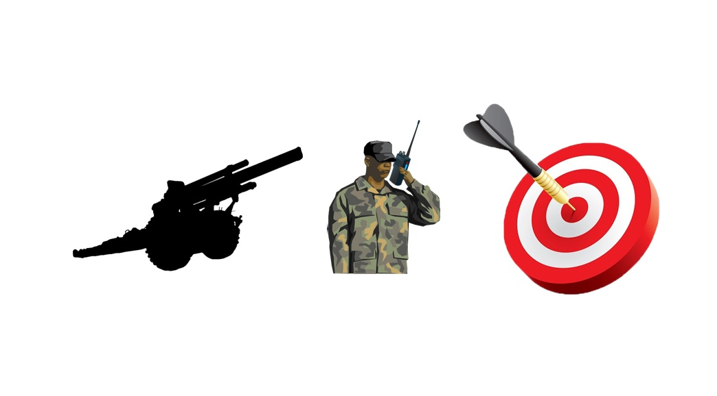
Prayer = Walkie-talkie to God
God’s Answers
Prayer
Target: The Lost and the Enemy

Slide 18
4. The Result (Matthew 10)
Prayer leads us to be part of the solution to our prayers!

Slide 19
4. The Result (Matthew 10)
Prayer leads us to be part of the solution to our prayers!
Conclusion: Therefore, missions without prayer is impossible.

Slide 20
5. Applications
Pray
Remind yourselves that you’re in war!
Actively participate in Saturday Prayer Meetings

Slide 21
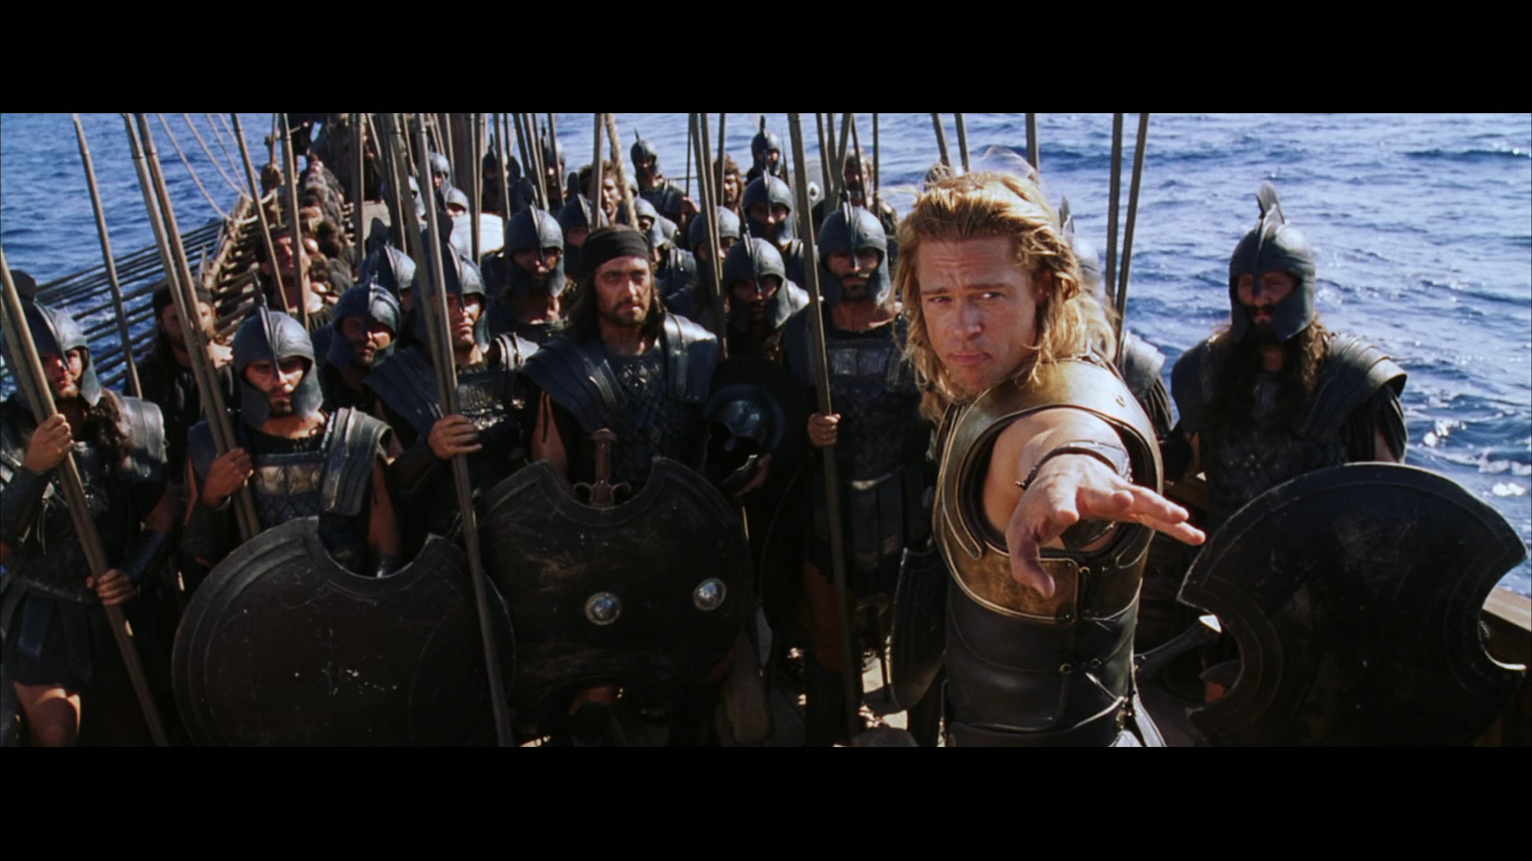

Slide 22
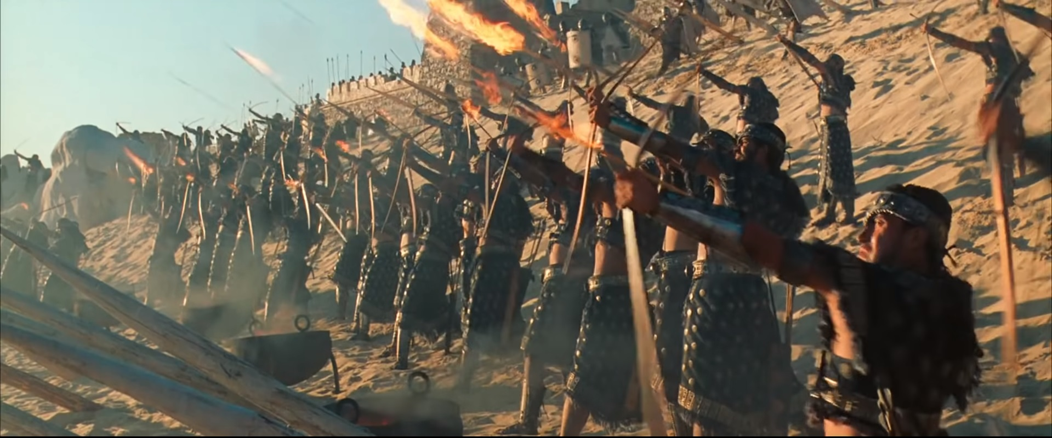

Slide 23
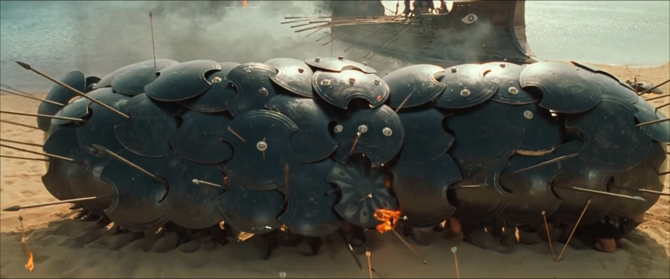

Slide 24
TWO PRACTICAL QUESTIONS FOR OUR EVERYDAY LIFE
Who are some lost people that God is asking you to pray for?
Where are some areas in the world or even here in our church that we can pray to the Lord of the Harvest to send workers into His harvest field?
*** Let’s spend some time praying for these specific things (2-3 minutes).

