Slide 1


Slide 2
Creative in God’s Image
A Special Sunday Message
Genesis 1:27-31
© January 20, 2019
Wade Harlan
Notes:
2

Slide 3
A Opening Favor for Wade
A warm-up exercise: Everyone needs:
a pen or pencil and the blank backside of the sermon notes.
Take 30 seconds to draw the person next to you as best you can in that amount of time.
Share your pictures with each other.
Notes:
Please do me a favor

Slide 4
A Classic Exercise in the Study of Creativity
Adults: fear the evaluation of our peers and are embarrassed to show our ideas to our them so there is nervous laughter, and even apologies.
- Like Adam and Eve. We feel vulnerable and cover our “nakedness.”
Kindergartners: they aren’t embarrassed afterwards. They typically are happy and want to show others what they’ve created.
Notes:
I want us to start by doing a classic exercise popularized in the 1960s by Dr. Bob McKim, the director of Design Studies at Stanford University. To do that I need everyone to take out a pen and the blank side of your bulletin. Now turn to the person on either side of you (preferably not your spouse) and in just a second I’m going to give you 30 seconds to draw that person from the shoulders up as best you can. Ready, Get set, Go! 30 seconds. STOP! (Followed by laughter and embarrassment and a few sorrys and apologies.) (Debrief: Creativity is in steep decline among adults but almost ubiquitous among kindergartners.) “This is what happens every time with adults. It appears that we fear the evaluation of our peers and are embarrassed to show our ideas to our them so there is nervous laughter, and even apologies.
What’s interesting is that when this is done with Kindergartners they aren’t embarrassed afterwards. They typically are happy and want to show others what they’ve created.

Slide 5
The Great Creativity Heist
In kindergarten 90% of children test as being creative.
In 2nd grade 10% of children test as creative.
Notes:
Madeleine L’Engle the famous author of “A Wrinkle in Time”

Slide 6
Creativity
Creativity is: “when an individual/group uses ideas, images or concepts that they previously never or rarely used in something they make .”
Creativity isn’t just for artists, it applies to everyone.

Slide 7
God is creative, He loves to create.
God’s way of communicating is extremely creative. It is:
1. Impactful/Transformational
Memorable/creative
Often unexpected
Uniqueand varied
Hand-tailored to the audience
Multi-sensory
Captivating
2. God’s secret weapon & the most powerful communicational method ever devised is:
Incarnational teaching.
Notes:
A. Memorable/creative – Jesus often spoke in parables that were easy to remember and think about long afterwards. Jesus said that he used them so that only those that truly were hungry for the truth would be able to understand them. All of the following examples made God’s communication memorable.
B. Often unexpected – the Sermon on the Mount was filled with love your enemy, return good for evil, to live you must die, don’t murder but don’t say “you fool”, don’t swear at all, let your yes be yes, don’t just not commit adultery, don’t have lustful thoughts, … He washed his disciples feet. God rebuked Balaam by speaking through his donkey, he spoke to Gideon through drying a lamb’s fleece, In Daniel a hand appeared and started writing on the wall. Do you think that was expected? Memorable? God tells the story of the Father (in Middle-eastern culture) who runs and falls at his wayward son’s feet to welcome him back. Was that expected?
C. Unique and varied - God & Jesus used stories, poetry, proverbs, songs, parables, He used visions, dreams, he spoke through a burning bush, sometimes he speaks to people’s hearts, sometimes to their minds, sometimes he impacted their body. Just look at ways we rebuked or punished disobedience, Adam & Eve felt shame, the wicked world was wiped out by a flood, at Babel people’s languages were confused, Pharaoh’s army was crushed in the Red Sea, Moses broke the 10 commandments, he made a generation wander in the wilderness, he brought the Jericho walls down through marching, trumpets and shouting, Gideon’s enemies were defeated by the sound of “rushing wind”, Goliath was defeated by a rock from a teenage boys sling, Ananius and Syphirra were struck down dead for lying, Nebuchadnezzar went insane, - washing the disciples feet (unexpected, multi-sensory) God uses the story of Isaac and Rebekah’s dysfunctional family to teach about the devastating effects of favoritism and poor communication in the home. God uses the confession of Jonah’s running from God and hatred of Gentiles to rebuke his people for their lack of concern for the Gentiles, God makes a hated Samaritan the hero of the story about loving your neighbor.
D. Hand-tailored to the audience (this makes it unexpected and memorable) his metaphors and analogies were from everyday life of ordinary people: I am the bread of life, light of the world, the door of the sheep, the good shepherd, the resurrection and the life, the way, the truth and the life , the true vine, Jacob “the deciever” was decieved by his sons, his disciples were fishermen and were told to he would make them fishers of men, David was told to shepherd God’s flock, Paul persecuted the Gentiles but God called him to be his apostle to the Gentiles, Esther doesn’t even mention God, part of Daniel is written in Assyrian, 42 authors over 4000 years wrote the Bible each carried by the Holy Spirit yet also using their own personality and style.
E. Multi-sensory the Egyptians had to endure 10 plagues while the Israelites watched, uneffected, 10 plagues –Darkness, lice, frogs, boils, did you smell the rotting frogs, to get rid
- the Passover – two weeks feeding, killing, cooking, eating, using the blood of the lamb.
F. Captivating/Impactful – he appeals to our hearts, “capturing us and bringing us back”, captured audiences attention. In the New Testament church he used preaching, miracles, prophecy, interpreted tongues, a word of knowledge, songs and hymns, Jesus tells a parable then walks away (they were captured! They followed him to ask him what he meant.)
And finally God’s secret weapon. The most powerful communicational method ever devised - - -
G. Incarnational teaching – Jesus lived out the message. he became the message, the messenger was the message. Hebrews – various times and different ways spoke in the past but now has spoken through his son.

Slide 8
Is God’s Creativity Needed in Communication Today?
Yes! Boredom is the #1 reason students don’t like their classes.
Student test scores with:
Boring Teacher: 45
Average Teacher: 70
Dynamic teacher: 90 Students learn twice as much then with the boring teacher!!!
Notes:
Please don’t fall asleep during talk on creativity – it’ll make me look like such a hypocrite!

Slide 9
God got pleasure from being creative.
“God saw everything that he had made, & behold, it was very good!”
Genesis 1: 31
We get pleasure from being creative because we’re created in His image.
The goal is not creativity for creativity’s sake but for God’s sake.
Notes:
Please don’t fall asleep during talk on creativity – it’ll make me look like such a hypocrite!

Slide 10
Creativity
3 Results of Creativity:
1. A more interesting world filled with variety
2. Pleasure
3. Memorable and impactful communication = learning!
How to recapture or stimulate our creativity?
Notes:
Please don’t fall asleep during talk on creativity – it’ll make me look like such a hypocrite!

Slide 11
How to recapture or stimulate our creativity?
1. Pray
2. Steal Copy
Start a swipe file - your own personal creativity iceberg
Find a Monet of your very own.
Notes:
Please don’t fall asleep during talk on creativity – it’ll make me look like such a hypocrite!

Slide 12
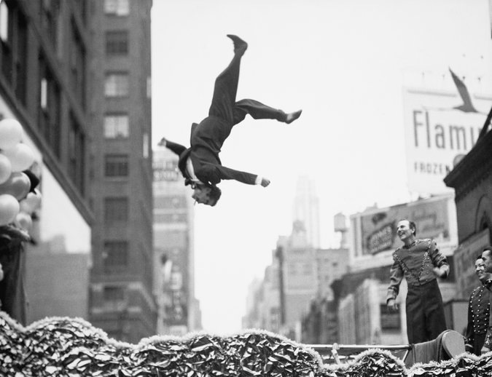
Notes:
Bill Hayes, SEPT. 13, 2014 NY Times article “A Monet of One’s Own”
There’s no better place to play hooky in New York these days than the New York Metropolitan Art Museum When you go - I suggest you bring a thesaurus. Because it wasn’t long before we found words failing us. An image of an acrobat caught midleap on a Manhattan street, for instance, struck the three of us as the epitome of “amazing.” So did another photo. Then another. Upon seeing the first few dozen of the more than 175 prints on view we pledged that we would not use that word to describe every single photo. Beautiful, incredible, joyful, strange, very sad — we made it as far as the second room before we were back to the A’s.
“It is just so... amazing,” said Katy, who’s 18 and an aspiring photographer, as if she’d been rendered helpless by yet another example of the Bronx-born artist’s particular genius for street photography When we reached the last room, I asked Katy which picture was her favorite. She led me back to the one that had stumped her in the synonym department. Her sister, Emily, who’s 14 and had been off wandering through the Met’s collection of European paintings, then showed me her favorite piece in the museum: a Monet water lily painting (the first she’d ever seen) from 1919.
This is when I let each girl in on a secret: It can be yours. No different from falling in love with a song, one may fall in love with a work of art and claim it as one’s own. Ownership does not come free. One must spend time with it; visit at different times of the day or evening; and bring to it one’s full attention. The investment will be repaid as one discovers something new with each viewing — say, a detail in the background, a person nearly cropped from the picture frame, or a tiny patch of canvas left unpainted, deliberately so, one may assume, as if to remind you not to take all the painted parts for granted.
This is true not just for New Yorkers but for anyone anywhere with art to be visited — art being a relative term, in my definition. Your Monet may, in fact, be an unpolished gemstone or mineral element. Natural history museums are filled with beauties fairly begging to be adopted. Stay alert. Next time a tattered Egyptian mummy speaks to you across the ages, don’t walk away. Stay a while. Spend some time with it. Give it a proper name: Yours.
But don’t be hasty. You must be sure you are besotted. When it happens, you will know. A couple of years back, I spent much of Memorial Day at the Museum of Modern Art with my friend Oliver, a self-described philistine when it comes to art. He struggled to see the value in the work of the performance artist who sat gazing into the eyes of museum visitors. And the enormous, bright red Barnett Newman painting, “Vir Heroicus Sublimis,” got him all worked up, railing against the pretensions of abstract expressionism.
This was my cue to lead Oliver to another gallery on another floor and steer him toward an early, rose-tinted Picasso. He smiled and he stayed and stayed and stayed, a self-appointed sentinel to Picasso’s “Boy Leading a Horse.”
It’s yours, I said. Congratulations.
Perhaps the best part about possessing art in this way is that what’s mine can be yours, and vice versa. In fact, I would not be surprised if half of New York City has also put dibs on the Monet that Emily chose. This made it no less hers.
I brought her in closer to her new acquisition: “Emily, meet your Monet. Monet, Emily.”
Words did not fail her: “Hello, beautiful,” she whispered.

Slide 13
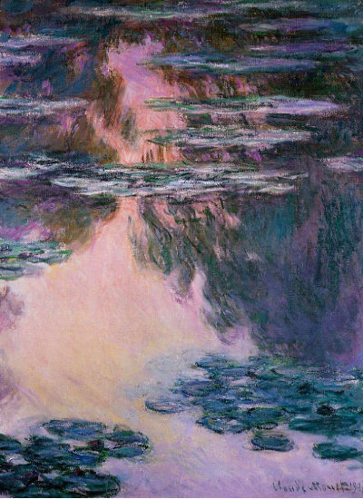
Notes:
Bill Hayes NY Times article Everyone should have a Monet of their own, shared with others, but its yours.
There’s no better place to play hooky in New York these days than the New York Metropolitan Art Museum When you go - I suggest you bring a thesaurus. Because it wasn’t long before we found words failing us. An image of an acrobat caught midleap on a Manhattan street, for instance, struck the three of us as the epitome of “amazing.” So did another photo. Then another. Upon seeing the first few dozen of the more than 175 prints on view we pledged that we would not use that word to describe every single photo. Beautiful, incredible, joyful, strange, very sad — we made it as far as the second room before we were back to the A’s.
“It is just so... amazing,” said Katy, who’s 18 and an aspiring photographer, as if she’d been rendered helpless by yet another example of the Bronx-born artist’s particular genius for street photography When we reached the last room, I asked Katy which picture was her favorite. She led me back to the one that had stumped her in the synonym department. Her sister, Emily, who’s 14 and had been off wandering through the Met’s collection of European paintings, then showed me her favorite piece in the museum: a Monet water lily painting (the first she’d ever seen) from 1919.
This is when I let each girl in on a secret: It can be yours. No different from falling in love with a song, one may fall in love with a work of art and claim it as one’s own. Ownership does not come free. One must spend time with it; visit at different times of the day or evening; and bring to it one’s full attention. The investment will be repaid as one discovers something new with each viewing — say, a detail in the background, a person nearly cropped from the picture frame, or a tiny patch of canvas left unpainted, deliberately so, one may assume, as if to remind you not to take all the painted parts for granted.
This is true not just for New Yorkers but for anyone anywhere with art to be visited — art being a relative term, in my definition. Your Monet may, in fact, be an unpolished gemstone or mineral element. Natural history museums are filled with beauties fairly begging to be adopted. Stay alert. Next time a tattered Egyptian mummy speaks to you across the ages, don’t walk away. Stay a while. Spend some time with it. Give it a proper name: Yours.
But don’t be hasty. You must be sure you are besotted. When it happens, you will know. A couple of years back, I spent much of Memorial Day at the Museum of Modern Art with my friend Oliver, a self-described philistine when it comes to art. He struggled to see the value in the work of the performance artist who sat gazing into the eyes of museum visitors. And the enormous, bright red Barnett Newman painting, “Vir Heroicus Sublimis,” got him all worked up, railing against the pretensions of abstract expressionism.
This was my cue to lead Oliver to another gallery on another floor and steer him toward an early, rose-tinted Picasso. He smiled and he stayed and stayed and stayed, a self-appointed sentinel to Picasso’s “Boy Leading a Horse.”
It’s yours, I said. Congratulations.
Perhaps the best part about possessing art in this way is that what’s mine can be yours, and vice versa. In fact, I would not be surprised if half of New York City has also put dibs on the Monet that Emily chose. This made it no less hers.
I brought her in closer to her new acquisition: “Emily, meet your Monet. Monet, Emily.”
Words did not fail her: “Hello, beautiful,” she whispered.

Slide 14
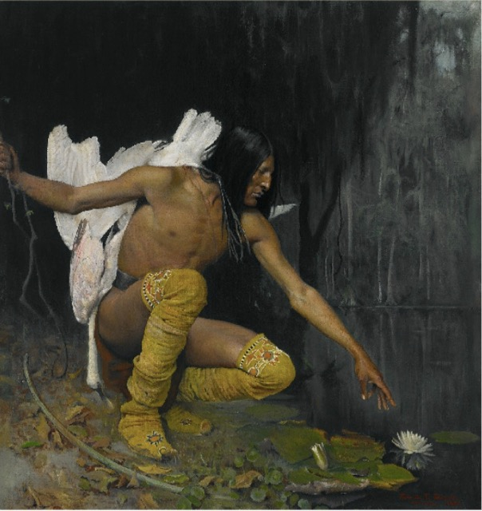
Notes:
1887 – by American George de Forest Brush - world of darkness, graceful warrior, pure (godly, angelic) Lee Juarez, Kiowa Indian Crystal Bridges Museum of American Art, Arkansas

Slide 15
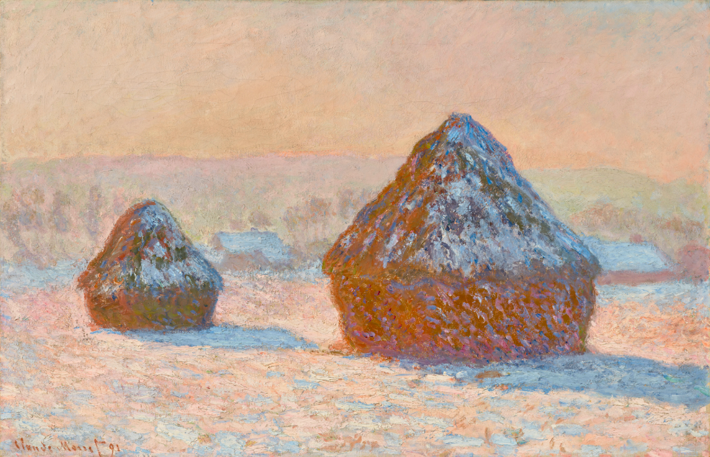

Slide 16
How to recapture or stimulate our creativity?
1. Pray
2. Steal Copy
Start a swipe file - your own personal creativity iceberg
Find a Monet of your very own.
Start more than one project.
Read books!
Parents model it! And praise and enjoy it in your children!
Have a “Creativity Week” at CrossWay or in your home this year, hang things on a wall.
Notes:
Please don’t fall asleep during talk on creativity – it’ll make me look like such a hypocrite!

Slide 17
Practical Advice Regarding Creativity
Realize the typical stages of a creative project.
This is the best idea ever!
Okay, this is harder than I thought.
This is going to take some serious work.
This sucks and is boring.
This is hopeless! What was I thinking?!!
It will be good to finish because at least I’ll learn something for next time.
It’s done! It could be better, but it’s not as bad as I once thought it would be!
Notes:
From Steal Like An Artist

Slide 18
Practical Advice Regarding Creativity
1. Realize the typical stages of a creative project.
2. Fake it ‘til you make it.
3. Creativity is a learned skill and can be improved through practice.
4. Focus on stewarding your creativity rather than the praise of people.
Notes:
Please don’t fall asleep during talk on creativity – it’ll make me look like such a hypocrite!

Slide 19
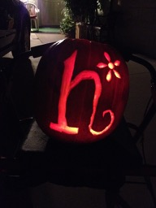

Slide 20


Slide 21


Slide 22


Slide 23


Slide 24


Slide 25


Slide 26


Slide 27


Slide 28


Slide 29
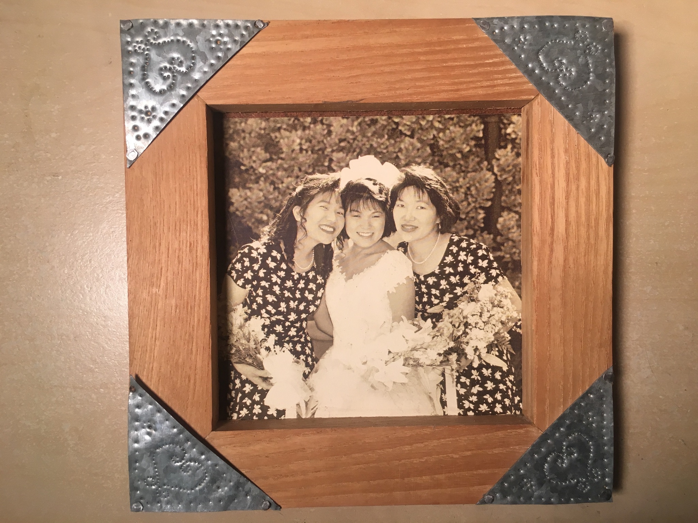

Slide 30


Slide 31


Slide 32


Slide 33
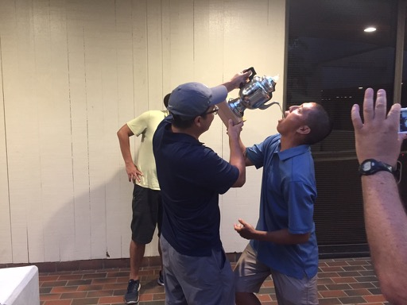

Slide 34


Slide 35


Slide 36


Slide 37


Slide 38
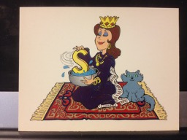

Slide 39


Slide 40


Slide 41


Slide 42


Slide 43


Slide 44


Slide 45


Slide 46


Slide 47


Slide 48


Slide 49


Slide 50


Slide 51


Slide 52


Slide 53


Slide 54


Slide 55


Slide 56


Slide 57


Slide 58

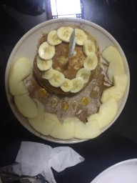


Slide 59


Slide 60


Slide 61


Slide 62


Slide 63
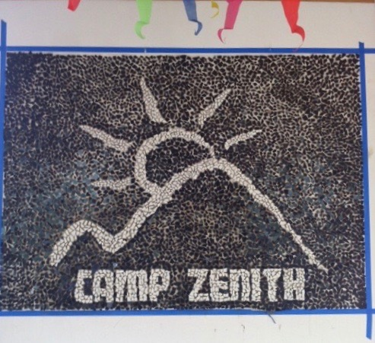

Slide 64
Notes:
Bill Hayes, SEPT. 13, 2014 NY Times article “A Monet of One’s Own”
There’s no better place to play hooky in New York these days than the New York Metropolitan Art Museum When you go - I suggest you bring a thesaurus. Because it wasn’t long before we found words failing us. An image of an acrobat caught midleap on a Manhattan street, for instance, struck the three of us as the epitome of “amazing.” So did another photo. Then another. Upon seeing the first few dozen of the more than 175 prints on view we pledged that we would not use that word to describe every single photo. Beautiful, incredible, joyful, strange, very sad — we made it as far as the second room before we were back to the A’s.
“It is just so... amazing,” said Katy, who’s 18 and an aspiring photographer, as if she’d been rendered helpless by yet another example of the Bronx-born artist’s particular genius for street photography When we reached the last room, I asked Katy which picture was her favorite. She led me back to the one that had stumped her in the synonym department. Her sister, Emily, who’s 14 and had been off wandering through the Met’s collection of European paintings, then showed me her favorite piece in the museum: a Monet water lily painting (the first she’d ever seen) from 1919.
This is when I let each girl in on a secret: It can be yours. No different from falling in love with a song, one may fall in love with a work of art and claim it as one’s own. Ownership does not come free. One must spend time with it; visit at different times of the day or evening; and bring to it one’s full attention. The investment will be repaid as one discovers something new with each viewing — say, a detail in the background, a person nearly cropped from the picture frame, or a tiny patch of canvas left unpainted, deliberately so, one may assume, as if to remind you not to take all the painted parts for granted.
This is true not just for New Yorkers but for anyone anywhere with art to be visited — art being a relative term, in my definition. Your Monet may, in fact, be an unpolished gemstone or mineral element. Natural history museums are filled with beauties fairly begging to be adopted. Stay alert. Next time a tattered Egyptian mummy speaks to you across the ages, don’t walk away. Stay a while. Spend some time with it. Give it a proper name: Yours.
But don’t be hasty. You must be sure you are besotted. When it happens, you will know. A couple of years back, I spent much of Memorial Day at the Museum of Modern Art with my friend Oliver, a self-described philistine when it comes to art. He struggled to see the value in the work of the performance artist who sat gazing into the eyes of museum visitors. And the enormous, bright red Barnett Newman painting, “Vir Heroicus Sublimis,” got him all worked up, railing against the pretensions of abstract expressionism.
This was my cue to lead Oliver to another gallery on another floor and steer him toward an early, rose-tinted Picasso. He smiled and he stayed and stayed and stayed, a self-appointed sentinel to Picasso’s “Boy Leading a Horse.”
It’s yours, I said. Congratulations.
Perhaps the best part about possessing art in this way is that what’s mine can be yours, and vice versa. In fact, I would not be surprised if half of New York City has also put dibs on the Monet that Emily chose. This made it no less hers.
I brought her in closer to her new acquisition: “Emily, meet your Monet. Monet, Emily.”
Words did not fail her: “Hello, beautiful,” she whispered.

Slide 65
Notes:
Bill Hayes, SEPT. 13, 2014 NY Times article “A Monet of One’s Own”
There’s no better place to play hooky in New York these days than the New York Metropolitan Art Museum When you go - I suggest you bring a thesaurus. Because it wasn’t long before we found words failing us. An image of an acrobat caught midleap on a Manhattan street, for instance, struck the three of us as the epitome of “amazing.” So did another photo. Then another. Upon seeing the first few dozen of the more than 175 prints on view we pledged that we would not use that word to describe every single photo. Beautiful, incredible, joyful, strange, very sad — we made it as far as the second room before we were back to the A’s.
“It is just so... amazing,” said Katy, who’s 18 and an aspiring photographer, as if she’d been rendered helpless by yet another example of the Bronx-born artist’s particular genius for street photography When we reached the last room, I asked Katy which picture was her favorite. She led me back to the one that had stumped her in the synonym department. Her sister, Emily, who’s 14 and had been off wandering through the Met’s collection of European paintings, then showed me her favorite piece in the museum: a Monet water lily painting (the first she’d ever seen) from 1919.
This is when I let each girl in on a secret: It can be yours. No different from falling in love with a song, one may fall in love with a work of art and claim it as one’s own. Ownership does not come free. One must spend time with it; visit at different times of the day or evening; and bring to it one’s full attention. The investment will be repaid as one discovers something new with each viewing — say, a detail in the background, a person nearly cropped from the picture frame, or a tiny patch of canvas left unpainted, deliberately so, one may assume, as if to remind you not to take all the painted parts for granted.
This is true not just for New Yorkers but for anyone anywhere with art to be visited — art being a relative term, in my definition. Your Monet may, in fact, be an unpolished gemstone or mineral element. Natural history museums are filled with beauties fairly begging to be adopted. Stay alert. Next time a tattered Egyptian mummy speaks to you across the ages, don’t walk away. Stay a while. Spend some time with it. Give it a proper name: Yours.
But don’t be hasty. You must be sure you are besotted. When it happens, you will know. A couple of years back, I spent much of Memorial Day at the Museum of Modern Art with my friend Oliver, a self-described philistine when it comes to art. He struggled to see the value in the work of the performance artist who sat gazing into the eyes of museum visitors. And the enormous, bright red Barnett Newman painting, “Vir Heroicus Sublimis,” got him all worked up, railing against the pretensions of abstract expressionism.
This was my cue to lead Oliver to another gallery on another floor and steer him toward an early, rose-tinted Picasso. He smiled and he stayed and stayed and stayed, a self-appointed sentinel to Picasso’s “Boy Leading a Horse.”
It’s yours, I said. Congratulations.
Perhaps the best part about possessing art in this way is that what’s mine can be yours, and vice versa. In fact, I would not be surprised if half of New York City has also put dibs on the Monet that Emily chose. This made it no less hers.
I brought her in closer to her new acquisition: “Emily, meet your Monet. Monet, Emily.”
Words did not fail her: “Hello, beautiful,” she whispered.

Slide 66
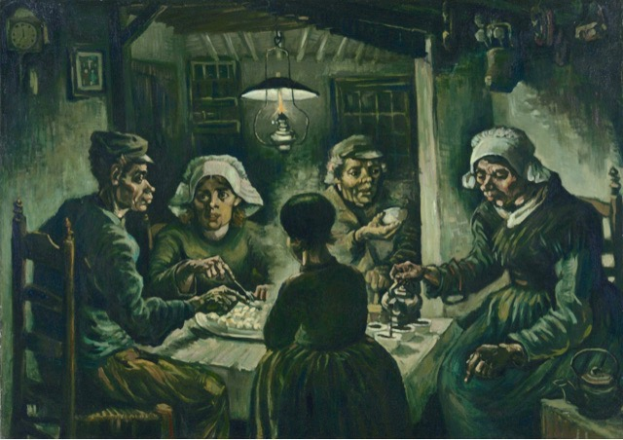

Slide 67
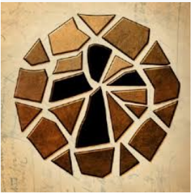

Slide 68


Slide 69


Slide 70


Slide 71
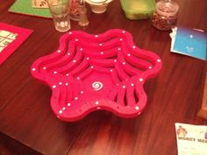
Notes:
Bill Hayes, SEPT. 13, 2014 NY Times article “A Monet of One’s Own”
There’s no better place to play hooky in New York these days than the New York Metropolitan Art Museum When you go - I suggest you bring a thesaurus. Because it wasn’t long before we found words failing us. An image of an acrobat caught midleap on a Manhattan street, for instance, struck the three of us as the epitome of “amazing.” So did another photo. Then another. Upon seeing the first few dozen of the more than 175 prints on view we pledged that we would not use that word to describe every single photo. Beautiful, incredible, joyful, strange, very sad — we made it as far as the second room before we were back to the A’s.
“It is just so... amazing,” said Katy, who’s 18 and an aspiring photographer, as if she’d been rendered helpless by yet another example of the Bronx-born artist’s particular genius for street photography When we reached the last room, I asked Katy which picture was her favorite. She led me back to the one that had stumped her in the synonym department. Her sister, Emily, who’s 14 and had been off wandering through the Met’s collection of European paintings, then showed me her favorite piece in the museum: a Monet water lily painting (the first she’d ever seen) from 1919.
This is when I let each girl in on a secret: It can be yours. No different from falling in love with a song, one may fall in love with a work of art and claim it as one’s own. Ownership does not come free. One must spend time with it; visit at different times of the day or evening; and bring to it one’s full attention. The investment will be repaid as one discovers something new with each viewing — say, a detail in the background, a person nearly cropped from the picture frame, or a tiny patch of canvas left unpainted, deliberately so, one may assume, as if to remind you not to take all the painted parts for granted.
This is true not just for New Yorkers but for anyone anywhere with art to be visited — art being a relative term, in my definition. Your Monet may, in fact, be an unpolished gemstone or mineral element. Natural history museums are filled with beauties fairly begging to be adopted. Stay alert. Next time a tattered Egyptian mummy speaks to you across the ages, don’t walk away. Stay a while. Spend some time with it. Give it a proper name: Yours.
But don’t be hasty. You must be sure you are besotted. When it happens, you will know. A couple of years back, I spent much of Memorial Day at the Museum of Modern Art with my friend Oliver, a self-described philistine when it comes to art. He struggled to see the value in the work of the performance artist who sat gazing into the eyes of museum visitors. And the enormous, bright red Barnett Newman painting, “Vir Heroicus Sublimis,” got him all worked up, railing against the pretensions of abstract expressionism.
This was my cue to lead Oliver to another gallery on another floor and steer him toward an early, rose-tinted Picasso. He smiled and he stayed and stayed and stayed, a self-appointed sentinel to Picasso’s “Boy Leading a Horse.”
It’s yours, I said. Congratulations.
Perhaps the best part about possessing art in this way is that what’s mine can be yours, and vice versa. In fact, I would not be surprised if half of New York City has also put dibs on the Monet that Emily chose. This made it no less hers.
I brought her in closer to her new acquisition: “Emily, meet your Monet. Monet, Emily.”
Words did not fail her: “Hello, beautiful,” she whispered.

Slide 72
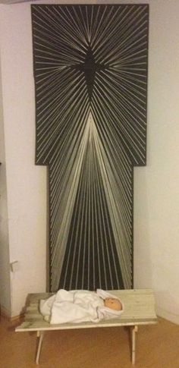
Notes:
Bill Hayes, SEPT. 13, 2014 NY Times article “A Monet of One’s Own”
There’s no better place to play hooky in New York these days than the New York Metropolitan Art Museum When you go - I suggest you bring a thesaurus. Because it wasn’t long before we found words failing us. An image of an acrobat caught midleap on a Manhattan street, for instance, struck the three of us as the epitome of “amazing.” So did another photo. Then another. Upon seeing the first few dozen of the more than 175 prints on view we pledged that we would not use that word to describe every single photo. Beautiful, incredible, joyful, strange, very sad — we made it as far as the second room before we were back to the A’s.
“It is just so... amazing,” said Katy, who’s 18 and an aspiring photographer, as if she’d been rendered helpless by yet another example of the Bronx-born artist’s particular genius for street photography When we reached the last room, I asked Katy which picture was her favorite. She led me back to the one that had stumped her in the synonym department. Her sister, Emily, who’s 14 and had been off wandering through the Met’s collection of European paintings, then showed me her favorite piece in the museum: a Monet water lily painting (the first she’d ever seen) from 1919.
This is when I let each girl in on a secret: It can be yours. No different from falling in love with a song, one may fall in love with a work of art and claim it as one’s own. Ownership does not come free. One must spend time with it; visit at different times of the day or evening; and bring to it one’s full attention. The investment will be repaid as one discovers something new with each viewing — say, a detail in the background, a person nearly cropped from the picture frame, or a tiny patch of canvas left unpainted, deliberately so, one may assume, as if to remind you not to take all the painted parts for granted.
This is true not just for New Yorkers but for anyone anywhere with art to be visited — art being a relative term, in my definition. Your Monet may, in fact, be an unpolished gemstone or mineral element. Natural history museums are filled with beauties fairly begging to be adopted. Stay alert. Next time a tattered Egyptian mummy speaks to you across the ages, don’t walk away. Stay a while. Spend some time with it. Give it a proper name: Yours.
But don’t be hasty. You must be sure you are besotted. When it happens, you will know. A couple of years back, I spent much of Memorial Day at the Museum of Modern Art with my friend Oliver, a self-described philistine when it comes to art. He struggled to see the value in the work of the performance artist who sat gazing into the eyes of museum visitors. And the enormous, bright red Barnett Newman painting, “Vir Heroicus Sublimis,” got him all worked up, railing against the pretensions of abstract expressionism.
This was my cue to lead Oliver to another gallery on another floor and steer him toward an early, rose-tinted Picasso. He smiled and he stayed and stayed and stayed, a self-appointed sentinel to Picasso’s “Boy Leading a Horse.”
It’s yours, I said. Congratulations.
Perhaps the best part about possessing art in this way is that what’s mine can be yours, and vice versa. In fact, I would not be surprised if half of New York City has also put dibs on the Monet that Emily chose. This made it no less hers.
I brought her in closer to her new acquisition: “Emily, meet your Monet. Monet, Emily.”
Words did not fail her: “Hello, beautiful,” she whispered.

Slide 73
Notes:
Bill Hayes, SEPT. 13, 2014 NY Times article “A Monet of One’s Own”
There’s no better place to play hooky in New York these days than the New York Metropolitan Art Museum When you go - I suggest you bring a thesaurus. Because it wasn’t long before we found words failing us. An image of an acrobat caught midleap on a Manhattan street, for instance, struck the three of us as the epitome of “amazing.” So did another photo. Then another. Upon seeing the first few dozen of the more than 175 prints on view we pledged that we would not use that word to describe every single photo. Beautiful, incredible, joyful, strange, very sad — we made it as far as the second room before we were back to the A’s.
“It is just so... amazing,” said Katy, who’s 18 and an aspiring photographer, as if she’d been rendered helpless by yet another example of the Bronx-born artist’s particular genius for street photography When we reached the last room, I asked Katy which picture was her favorite. She led me back to the one that had stumped her in the synonym department. Her sister, Emily, who’s 14 and had been off wandering through the Met’s collection of European paintings, then showed me her favorite piece in the museum: a Monet water lily painting (the first she’d ever seen) from 1919.
This is when I let each girl in on a secret: It can be yours. No different from falling in love with a song, one may fall in love with a work of art and claim it as one’s own. Ownership does not come free. One must spend time with it; visit at different times of the day or evening; and bring to it one’s full attention. The investment will be repaid as one discovers something new with each viewing — say, a detail in the background, a person nearly cropped from the picture frame, or a tiny patch of canvas left unpainted, deliberately so, one may assume, as if to remind you not to take all the painted parts for granted.
This is true not just for New Yorkers but for anyone anywhere with art to be visited — art being a relative term, in my definition. Your Monet may, in fact, be an unpolished gemstone or mineral element. Natural history museums are filled with beauties fairly begging to be adopted. Stay alert. Next time a tattered Egyptian mummy speaks to you across the ages, don’t walk away. Stay a while. Spend some time with it. Give it a proper name: Yours.
But don’t be hasty. You must be sure you are besotted. When it happens, you will know. A couple of years back, I spent much of Memorial Day at the Museum of Modern Art with my friend Oliver, a self-described philistine when it comes to art. He struggled to see the value in the work of the performance artist who sat gazing into the eyes of museum visitors. And the enormous, bright red Barnett Newman painting, “Vir Heroicus Sublimis,” got him all worked up, railing against the pretensions of abstract expressionism.
This was my cue to lead Oliver to another gallery on another floor and steer him toward an early, rose-tinted Picasso. He smiled and he stayed and stayed and stayed, a self-appointed sentinel to Picasso’s “Boy Leading a Horse.”
It’s yours, I said. Congratulations.
Perhaps the best part about possessing art in this way is that what’s mine can be yours, and vice versa. In fact, I would not be surprised if half of New York City has also put dibs on the Monet that Emily chose. This made it no less hers.
I brought her in closer to her new acquisition: “Emily, meet your Monet. Monet, Emily.”
Words did not fail her: “Hello, beautiful,” she whispered.

Slide 74

Notes:
Bill Hayes, SEPT. 13, 2014 NY Times article “A Monet of One’s Own”
There’s no better place to play hooky in New York these days than the New York Metropolitan Art Museum When you go - I suggest you bring a thesaurus. Because it wasn’t long before we found words failing us. An image of an acrobat caught midleap on a Manhattan street, for instance, struck the three of us as the epitome of “amazing.” So did another photo. Then another. Upon seeing the first few dozen of the more than 175 prints on view we pledged that we would not use that word to describe every single photo. Beautiful, incredible, joyful, strange, very sad — we made it as far as the second room before we were back to the A’s.
“It is just so... amazing,” said Katy, who’s 18 and an aspiring photographer, as if she’d been rendered helpless by yet another example of the Bronx-born artist’s particular genius for street photography When we reached the last room, I asked Katy which picture was her favorite. She led me back to the one that had stumped her in the synonym department. Her sister, Emily, who’s 14 and had been off wandering through the Met’s collection of European paintings, then showed me her favorite piece in the museum: a Monet water lily painting (the first she’d ever seen) from 1919.
This is when I let each girl in on a secret: It can be yours. No different from falling in love with a song, one may fall in love with a work of art and claim it as one’s own. Ownership does not come free. One must spend time with it; visit at different times of the day or evening; and bring to it one’s full attention. The investment will be repaid as one discovers something new with each viewing — say, a detail in the background, a person nearly cropped from the picture frame, or a tiny patch of canvas left unpainted, deliberately so, one may assume, as if to remind you not to take all the painted parts for granted.
This is true not just for New Yorkers but for anyone anywhere with art to be visited — art being a relative term, in my definition. Your Monet may, in fact, be an unpolished gemstone or mineral element. Natural history museums are filled with beauties fairly begging to be adopted. Stay alert. Next time a tattered Egyptian mummy speaks to you across the ages, don’t walk away. Stay a while. Spend some time with it. Give it a proper name: Yours.
But don’t be hasty. You must be sure you are besotted. When it happens, you will know. A couple of years back, I spent much of Memorial Day at the Museum of Modern Art with my friend Oliver, a self-described philistine when it comes to art. He struggled to see the value in the work of the performance artist who sat gazing into the eyes of museum visitors. And the enormous, bright red Barnett Newman painting, “Vir Heroicus Sublimis,” got him all worked up, railing against the pretensions of abstract expressionism.
This was my cue to lead Oliver to another gallery on another floor and steer him toward an early, rose-tinted Picasso. He smiled and he stayed and stayed and stayed, a self-appointed sentinel to Picasso’s “Boy Leading a Horse.”
It’s yours, I said. Congratulations.
Perhaps the best part about possessing art in this way is that what’s mine can be yours, and vice versa. In fact, I would not be surprised if half of New York City has also put dibs on the Monet that Emily chose. This made it no less hers.
I brought her in closer to her new acquisition: “Emily, meet your Monet. Monet, Emily.”
Words did not fail her: “Hello, beautiful,” she whispered.

Slide 75


Notes:
Bill Hayes, SEPT. 13, 2014 NY Times article “A Monet of One’s Own”
There’s no better place to play hooky in New York these days than the New York Metropolitan Art Museum When you go - I suggest you bring a thesaurus. Because it wasn’t long before we found words failing us. An image of an acrobat caught midleap on a Manhattan street, for instance, struck the three of us as the epitome of “amazing.” So did another photo. Then another. Upon seeing the first few dozen of the more than 175 prints on view we pledged that we would not use that word to describe every single photo. Beautiful, incredible, joyful, strange, very sad — we made it as far as the second room before we were back to the A’s.
“It is just so... amazing,” said Katy, who’s 18 and an aspiring photographer, as if she’d been rendered helpless by yet another example of the Bronx-born artist’s particular genius for street photography When we reached the last room, I asked Katy which picture was her favorite. She led me back to the one that had stumped her in the synonym department. Her sister, Emily, who’s 14 and had been off wandering through the Met’s collection of European paintings, then showed me her favorite piece in the museum: a Monet water lily painting (the first she’d ever seen) from 1919.
This is when I let each girl in on a secret: It can be yours. No different from falling in love with a song, one may fall in love with a work of art and claim it as one’s own. Ownership does not come free. One must spend time with it; visit at different times of the day or evening; and bring to it one’s full attention. The investment will be repaid as one discovers something new with each viewing — say, a detail in the background, a person nearly cropped from the picture frame, or a tiny patch of canvas left unpainted, deliberately so, one may assume, as if to remind you not to take all the painted parts for granted.
This is true not just for New Yorkers but for anyone anywhere with art to be visited — art being a relative term, in my definition. Your Monet may, in fact, be an unpolished gemstone or mineral element. Natural history museums are filled with beauties fairly begging to be adopted. Stay alert. Next time a tattered Egyptian mummy speaks to you across the ages, don’t walk away. Stay a while. Spend some time with it. Give it a proper name: Yours.
But don’t be hasty. You must be sure you are besotted. When it happens, you will know. A couple of years back, I spent much of Memorial Day at the Museum of Modern Art with my friend Oliver, a self-described philistine when it comes to art. He struggled to see the value in the work of the performance artist who sat gazing into the eyes of museum visitors. And the enormous, bright red Barnett Newman painting, “Vir Heroicus Sublimis,” got him all worked up, railing against the pretensions of abstract expressionism.
This was my cue to lead Oliver to another gallery on another floor and steer him toward an early, rose-tinted Picasso. He smiled and he stayed and stayed and stayed, a self-appointed sentinel to Picasso’s “Boy Leading a Horse.”
It’s yours, I said. Congratulations.
Perhaps the best part about possessing art in this way is that what’s mine can be yours, and vice versa. In fact, I would not be surprised if half of New York City has also put dibs on the Monet that Emily chose. This made it no less hers.
I brought her in closer to her new acquisition: “Emily, meet your Monet. Monet, Emily.”
Words did not fail her: “Hello, beautiful,” she whispered.

Slide 76
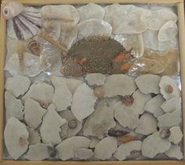
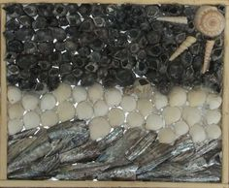
Notes:
Bill Hayes, SEPT. 13, 2014 NY Times article “A Monet of One’s Own”
There’s no better place to play hooky in New York these days than the New York Metropolitan Art Museum When you go - I suggest you bring a thesaurus. Because it wasn’t long before we found words failing us. An image of an acrobat caught midleap on a Manhattan street, for instance, struck the three of us as the epitome of “amazing.” So did another photo. Then another. Upon seeing the first few dozen of the more than 175 prints on view we pledged that we would not use that word to describe every single photo. Beautiful, incredible, joyful, strange, very sad — we made it as far as the second room before we were back to the A’s.
“It is just so... amazing,” said Katy, who’s 18 and an aspiring photographer, as if she’d been rendered helpless by yet another example of the Bronx-born artist’s particular genius for street photography When we reached the last room, I asked Katy which picture was her favorite. She led me back to the one that had stumped her in the synonym department. Her sister, Emily, who’s 14 and had been off wandering through the Met’s collection of European paintings, then showed me her favorite piece in the museum: a Monet water lily painting (the first she’d ever seen) from 1919.
This is when I let each girl in on a secret: It can be yours. No different from falling in love with a song, one may fall in love with a work of art and claim it as one’s own. Ownership does not come free. One must spend time with it; visit at different times of the day or evening; and bring to it one’s full attention. The investment will be repaid as one discovers something new with each viewing — say, a detail in the background, a person nearly cropped from the picture frame, or a tiny patch of canvas left unpainted, deliberately so, one may assume, as if to remind you not to take all the painted parts for granted.
This is true not just for New Yorkers but for anyone anywhere with art to be visited — art being a relative term, in my definition. Your Monet may, in fact, be an unpolished gemstone or mineral element. Natural history museums are filled with beauties fairly begging to be adopted. Stay alert. Next time a tattered Egyptian mummy speaks to you across the ages, don’t walk away. Stay a while. Spend some time with it. Give it a proper name: Yours.
But don’t be hasty. You must be sure you are besotted. When it happens, you will know. A couple of years back, I spent much of Memorial Day at the Museum of Modern Art with my friend Oliver, a self-described philistine when it comes to art. He struggled to see the value in the work of the performance artist who sat gazing into the eyes of museum visitors. And the enormous, bright red Barnett Newman painting, “Vir Heroicus Sublimis,” got him all worked up, railing against the pretensions of abstract expressionism.
This was my cue to lead Oliver to another gallery on another floor and steer him toward an early, rose-tinted Picasso. He smiled and he stayed and stayed and stayed, a self-appointed sentinel to Picasso’s “Boy Leading a Horse.”
It’s yours, I said. Congratulations.
Perhaps the best part about possessing art in this way is that what’s mine can be yours, and vice versa. In fact, I would not be surprised if half of New York City has also put dibs on the Monet that Emily chose. This made it no less hers.
I brought her in closer to her new acquisition: “Emily, meet your Monet. Monet, Emily.”
Words did not fail her: “Hello, beautiful,” she whispered.

Slide 77

Notes:
Bill Hayes, SEPT. 13, 2014 NY Times article “A Monet of One’s Own”
There’s no better place to play hooky in New York these days than the New York Metropolitan Art Museum When you go - I suggest you bring a thesaurus. Because it wasn’t long before we found words failing us. An image of an acrobat caught midleap on a Manhattan street, for instance, struck the three of us as the epitome of “amazing.” So did another photo. Then another. Upon seeing the first few dozen of the more than 175 prints on view we pledged that we would not use that word to describe every single photo. Beautiful, incredible, joyful, strange, very sad — we made it as far as the second room before we were back to the A’s.
“It is just so... amazing,” said Katy, who’s 18 and an aspiring photographer, as if she’d been rendered helpless by yet another example of the Bronx-born artist’s particular genius for street photography When we reached the last room, I asked Katy which picture was her favorite. She led me back to the one that had stumped her in the synonym department. Her sister, Emily, who’s 14 and had been off wandering through the Met’s collection of European paintings, then showed me her favorite piece in the museum: a Monet water lily painting (the first she’d ever seen) from 1919.
This is when I let each girl in on a secret: It can be yours. No different from falling in love with a song, one may fall in love with a work of art and claim it as one’s own. Ownership does not come free. One must spend time with it; visit at different times of the day or evening; and bring to it one’s full attention. The investment will be repaid as one discovers something new with each viewing — say, a detail in the background, a person nearly cropped from the picture frame, or a tiny patch of canvas left unpainted, deliberately so, one may assume, as if to remind you not to take all the painted parts for granted.
This is true not just for New Yorkers but for anyone anywhere with art to be visited — art being a relative term, in my definition. Your Monet may, in fact, be an unpolished gemstone or mineral element. Natural history museums are filled with beauties fairly begging to be adopted. Stay alert. Next time a tattered Egyptian mummy speaks to you across the ages, don’t walk away. Stay a while. Spend some time with it. Give it a proper name: Yours.
But don’t be hasty. You must be sure you are besotted. When it happens, you will know. A couple of years back, I spent much of Memorial Day at the Museum of Modern Art with my friend Oliver, a self-described philistine when it comes to art. He struggled to see the value in the work of the performance artist who sat gazing into the eyes of museum visitors. And the enormous, bright red Barnett Newman painting, “Vir Heroicus Sublimis,” got him all worked up, railing against the pretensions of abstract expressionism.
This was my cue to lead Oliver to another gallery on another floor and steer him toward an early, rose-tinted Picasso. He smiled and he stayed and stayed and stayed, a self-appointed sentinel to Picasso’s “Boy Leading a Horse.”
It’s yours, I said. Congratulations.
Perhaps the best part about possessing art in this way is that what’s mine can be yours, and vice versa. In fact, I would not be surprised if half of New York City has also put dibs on the Monet that Emily chose. This made it no less hers.
I brought her in closer to her new acquisition: “Emily, meet your Monet. Monet, Emily.”
Words did not fail her: “Hello, beautiful,” she whispered.

Slide 78

Notes:
Bill Hayes, SEPT. 13, 2014 NY Times article “A Monet of One’s Own”
There’s no better place to play hooky in New York these days than the New York Metropolitan Art Museum When you go - I suggest you bring a thesaurus. Because it wasn’t long before we found words failing us. An image of an acrobat caught midleap on a Manhattan street, for instance, struck the three of us as the epitome of “amazing.” So did another photo. Then another. Upon seeing the first few dozen of the more than 175 prints on view we pledged that we would not use that word to describe every single photo. Beautiful, incredible, joyful, strange, very sad — we made it as far as the second room before we were back to the A’s.
“It is just so... amazing,” said Katy, who’s 18 and an aspiring photographer, as if she’d been rendered helpless by yet another example of the Bronx-born artist’s particular genius for street photography When we reached the last room, I asked Katy which picture was her favorite. She led me back to the one that had stumped her in the synonym department. Her sister, Emily, who’s 14 and had been off wandering through the Met’s collection of European paintings, then showed me her favorite piece in the museum: a Monet water lily painting (the first she’d ever seen) from 1919.
This is when I let each girl in on a secret: It can be yours. No different from falling in love with a song, one may fall in love with a work of art and claim it as one’s own. Ownership does not come free. One must spend time with it; visit at different times of the day or evening; and bring to it one’s full attention. The investment will be repaid as one discovers something new with each viewing — say, a detail in the background, a person nearly cropped from the picture frame, or a tiny patch of canvas left unpainted, deliberately so, one may assume, as if to remind you not to take all the painted parts for granted.
This is true not just for New Yorkers but for anyone anywhere with art to be visited — art being a relative term, in my definition. Your Monet may, in fact, be an unpolished gemstone or mineral element. Natural history museums are filled with beauties fairly begging to be adopted. Stay alert. Next time a tattered Egyptian mummy speaks to you across the ages, don’t walk away. Stay a while. Spend some time with it. Give it a proper name: Yours.
But don’t be hasty. You must be sure you are besotted. When it happens, you will know. A couple of years back, I spent much of Memorial Day at the Museum of Modern Art with my friend Oliver, a self-described philistine when it comes to art. He struggled to see the value in the work of the performance artist who sat gazing into the eyes of museum visitors. And the enormous, bright red Barnett Newman painting, “Vir Heroicus Sublimis,” got him all worked up, railing against the pretensions of abstract expressionism.
This was my cue to lead Oliver to another gallery on another floor and steer him toward an early, rose-tinted Picasso. He smiled and he stayed and stayed and stayed, a self-appointed sentinel to Picasso’s “Boy Leading a Horse.”
It’s yours, I said. Congratulations.
Perhaps the best part about possessing art in this way is that what’s mine can be yours, and vice versa. In fact, I would not be surprised if half of New York City has also put dibs on the Monet that Emily chose. This made it no less hers.
I brought her in closer to her new acquisition: “Emily, meet your Monet. Monet, Emily.”
Words did not fail her: “Hello, beautiful,” she whispered.

Slide 79
Notes:
Bill Hayes, SEPT. 13, 2014 NY Times article “A Monet of One’s Own”
There’s no better place to play hooky in New York these days than the New York Metropolitan Art Museum When you go - I suggest you bring a thesaurus. Because it wasn’t long before we found words failing us. An image of an acrobat caught midleap on a Manhattan street, for instance, struck the three of us as the epitome of “amazing.” So did another photo. Then another. Upon seeing the first few dozen of the more than 175 prints on view we pledged that we would not use that word to describe every single photo. Beautiful, incredible, joyful, strange, very sad — we made it as far as the second room before we were back to the A’s.
“It is just so... amazing,” said Katy, who’s 18 and an aspiring photographer, as if she’d been rendered helpless by yet another example of the Bronx-born artist’s particular genius for street photography When we reached the last room, I asked Katy which picture was her favorite. She led me back to the one that had stumped her in the synonym department. Her sister, Emily, who’s 14 and had been off wandering through the Met’s collection of European paintings, then showed me her favorite piece in the museum: a Monet water lily painting (the first she’d ever seen) from 1919.
This is when I let each girl in on a secret: It can be yours. No different from falling in love with a song, one may fall in love with a work of art and claim it as one’s own. Ownership does not come free. One must spend time with it; visit at different times of the day or evening; and bring to it one’s full attention. The investment will be repaid as one discovers something new with each viewing — say, a detail in the background, a person nearly cropped from the picture frame, or a tiny patch of canvas left unpainted, deliberately so, one may assume, as if to remind you not to take all the painted parts for granted.
This is true not just for New Yorkers but for anyone anywhere with art to be visited — art being a relative term, in my definition. Your Monet may, in fact, be an unpolished gemstone or mineral element. Natural history museums are filled with beauties fairly begging to be adopted. Stay alert. Next time a tattered Egyptian mummy speaks to you across the ages, don’t walk away. Stay a while. Spend some time with it. Give it a proper name: Yours.
But don’t be hasty. You must be sure you are besotted. When it happens, you will know. A couple of years back, I spent much of Memorial Day at the Museum of Modern Art with my friend Oliver, a self-described philistine when it comes to art. He struggled to see the value in the work of the performance artist who sat gazing into the eyes of museum visitors. And the enormous, bright red Barnett Newman painting, “Vir Heroicus Sublimis,” got him all worked up, railing against the pretensions of abstract expressionism.
This was my cue to lead Oliver to another gallery on another floor and steer him toward an early, rose-tinted Picasso. He smiled and he stayed and stayed and stayed, a self-appointed sentinel to Picasso’s “Boy Leading a Horse.”
It’s yours, I said. Congratulations.
Perhaps the best part about possessing art in this way is that what’s mine can be yours, and vice versa. In fact, I would not be surprised if half of New York City has also put dibs on the Monet that Emily chose. This made it no less hers.
I brought her in closer to her new acquisition: “Emily, meet your Monet. Monet, Emily.”
Words did not fail her: “Hello, beautiful,” she whispered.

Slide 80

Notes:
Bill Hayes, SEPT. 13, 2014 NY Times article “A Monet of One’s Own”
There’s no better place to play hooky in New York these days than the New York Metropolitan Art Museum When you go - I suggest you bring a thesaurus. Because it wasn’t long before we found words failing us. An image of an acrobat caught midleap on a Manhattan street, for instance, struck the three of us as the epitome of “amazing.” So did another photo. Then another. Upon seeing the first few dozen of the more than 175 prints on view we pledged that we would not use that word to describe every single photo. Beautiful, incredible, joyful, strange, very sad — we made it as far as the second room before we were back to the A’s.
“It is just so... amazing,” said Katy, who’s 18 and an aspiring photographer, as if she’d been rendered helpless by yet another example of the Bronx-born artist’s particular genius for street photography When we reached the last room, I asked Katy which picture was her favorite. She led me back to the one that had stumped her in the synonym department. Her sister, Emily, who’s 14 and had been off wandering through the Met’s collection of European paintings, then showed me her favorite piece in the museum: a Monet water lily painting (the first she’d ever seen) from 1919.
This is when I let each girl in on a secret: It can be yours. No different from falling in love with a song, one may fall in love with a work of art and claim it as one’s own. Ownership does not come free. One must spend time with it; visit at different times of the day or evening; and bring to it one’s full attention. The investment will be repaid as one discovers something new with each viewing — say, a detail in the background, a person nearly cropped from the picture frame, or a tiny patch of canvas left unpainted, deliberately so, one may assume, as if to remind you not to take all the painted parts for granted.
This is true not just for New Yorkers but for anyone anywhere with art to be visited — art being a relative term, in my definition. Your Monet may, in fact, be an unpolished gemstone or mineral element. Natural history museums are filled with beauties fairly begging to be adopted. Stay alert. Next time a tattered Egyptian mummy speaks to you across the ages, don’t walk away. Stay a while. Spend some time with it. Give it a proper name: Yours.
But don’t be hasty. You must be sure you are besotted. When it happens, you will know. A couple of years back, I spent much of Memorial Day at the Museum of Modern Art with my friend Oliver, a self-described philistine when it comes to art. He struggled to see the value in the work of the performance artist who sat gazing into the eyes of museum visitors. And the enormous, bright red Barnett Newman painting, “Vir Heroicus Sublimis,” got him all worked up, railing against the pretensions of abstract expressionism.
This was my cue to lead Oliver to another gallery on another floor and steer him toward an early, rose-tinted Picasso. He smiled and he stayed and stayed and stayed, a self-appointed sentinel to Picasso’s “Boy Leading a Horse.”
It’s yours, I said. Congratulations.
Perhaps the best part about possessing art in this way is that what’s mine can be yours, and vice versa. In fact, I would not be surprised if half of New York City has also put dibs on the Monet that Emily chose. This made it no less hers.
I brought her in closer to her new acquisition: “Emily, meet your Monet. Monet, Emily.”
Words did not fail her: “Hello, beautiful,” she whispered.

Slide 81
PRACTICAL QUESTIONS FOR OUR EVERYDAY LIFE. CHOOSE ONE.
What is one simple way in your work, at home, in your parenting or in your life that you could be more Christlike by being more creative?
What is one thing, big or small that you created or were creative about in the last year that brought you pleasure?
How does it make you feel to realize that God and Jesus love variety and are VERY creative in the way they communicate?
How have you believed the lie that you are not “creative”?

