Slide 2
“Abide in Christ in Times of Suffering”
Session 3 [Saturday Evening]
All-Church Retreat 2016
© June 25, 2016
Pastor Chris Crossan
Notes:
2

Slide 3
John 15:1-2, 18-25
“I am the true vine, and my Father is the vinedresser. Every branch in me that does not bear fruit he takes away, and every branch that does bear fruit he prunes, that it may bear more fruit . . . “If the world hates you, know that it has hated me before it hated you. If you were of the world, the world would love you as its own; but because you are not of the world, but I chose you out of the world, therefore the world hates you. Remember the word that I said to you: ‘A servant is not greater than his master.’ If they persecuted me, they will also persecute you. If they kept my word, they will also keep yours. But all these things they will do to you on account of my name, because they do not know him who sent me. If I had not come and spoken to them, they would not have been guilty of sin, but now they have no excuse for their sin. Whoever hates me hates my Father also. If I had not done among them the works that no one else did, they would not be guilty of sin, but now they have seen and hated both me and my Father. But the word that is written in their Law must be fulfilled: ‘They hated me without a cause.

Slide 4
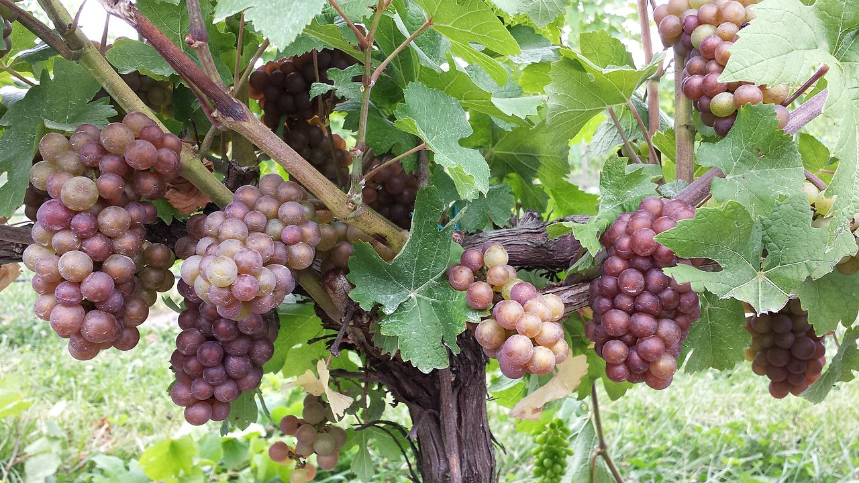
GOD’S PURPOSE IN PRUNING: TO BEAR MORE FRUIT
courtesy of BellviewMatt CC SA-3.0
(e

Slide 5
THE CHRISTIAN’S UNIQUE VIEW OF SUFFERING (JOB 1-2)
…the Lord said to Satan, “Have you considered my servant Job, that there is none like him on the earth, a blameless and upright man, who fears God and turns away from evil?” Then Satan answered the Lord and said, “Does Job fear God for no reason? Have you not put a hedge around him and his house and all that he has, on every side? You have blessed the work of his hands, and his possessions have increased in the land. But stretch out your hand and touch all that he has, and he will curse you to your face.” And the Lord said to Satan, “Behold, all that he has is in your hand. Only against him do not stretch out your hand.” So Satan went out from the presence of the Lord. Job 1:8-12

Slide 6
THE CHRISTIAN’S UNIQUE VIEW OF SUFFERING (JOB 1-2)
As an example of suffering and patience, brothers, take the prophets who spoke in the name of the Lord. Behold, we consider those blessed who remained steadfast. You have heard of the steadfastness of Job, and you have seen the purpose of the Lord, how the Lord is compassionate and merciful. James 5:10-11

Slide 7
WHO’S RESPONSIBLE FOR OUR SUFFERING?
The example of Joseph:
But Joseph said to them, “Do not fear, for am I in the place of God? As for you, you meant evil against me, but God meant it for good, to bring it about that many people should be kept alive, as they are today. So do not fear; I will provide for you and your little ones.” (Genesis 50:19-21)
The example of Jesus:
“Men of Israel, hear these words: Jesus of Nazareth, a man attested to you by God with mighty works and wonders and signs that God did through him in your midst, as you yourselves know— this Jesus, delivered up according to the definite plan and foreknowledge of God, you crucified and killed by the hands of lawless men.” (Acts 2:22-23)

Slide 8
WHO’S RESPONSIBLE FOR OUR SUFFERING?
Developing an eternal perspective
What we learned through our seasons of suffering

Slide 9
APPLICATION QUESTIONS
What one insight about pruning or the Christian’s unique view of suffering is most helpful for you? How did it change your perspective?
In what ways will you follow the example of Joseph and Jesus in facing your current hardships and suffering? What is your first step?
Having heard Chris & Karen’s lessons from their seasons of suffering, what wisdom have you drawn from their stories? How will you apply it?

