Slide 2
“Abide in Christ for a Life of True Significance”
Session 1 [Friday Evening]
All-Church Retreat 2016
© June 24, 2016
Pastor Chris Crossan
Notes:
2

Slide 3
This is my commandment, that you love one another as I have loved you. Greater love has no one than this, that someone lay down his life for his friends. John 15:12-13

Slide 4
WHAT DOES IT MEAN TO KNOW CHRIST?
“I am the true vine, and my Father is the vinedresser. Every branch in me that does not bear fruit he takes away, and every branch that does bear fruit he prunes, that it may bear more fruit. Already you are clean because of the word that I have spoken to you. Abide in me, and I in you. As the branch cannot bear fruit by itself, unless it abides in the vine, neither can you, unless you abide in me. I am the vine; you are the branches. Whoever abides in me and I in him, he it is that bears much fruit, for apart from me you can do nothing. If anyone does not abide in me he is thrown away like a branch and withers; and the branches are gathered, thrown into the fire, and burned. If you abide in me, and my words abide in you, ask whatever you wish, and it will be done for you. By this my Father is glorified, that you bear much fruit and so prove to be my disciples.” John 15:1-8

Slide 5
DO I HAVE A DESTINY TO FULFILL?
“This is my commandment, that you love one another
as I have loved you. Greater love has no one than this, that someone lay down his life for his friends. You are my friends if you do what I command you. No longer do I call you servants, for the servant does not know what his master is doing; but I have called you friends, for all that I have heard from my Father I have made known to you. You did not choose me, but I chose you and appointed you that you should go and bear fruit and that your fruit should abide, so that whatever you ask the Father in my name, he may give it to you. These things I command you, so that you will love one another. John 15:12-17

Slide 6
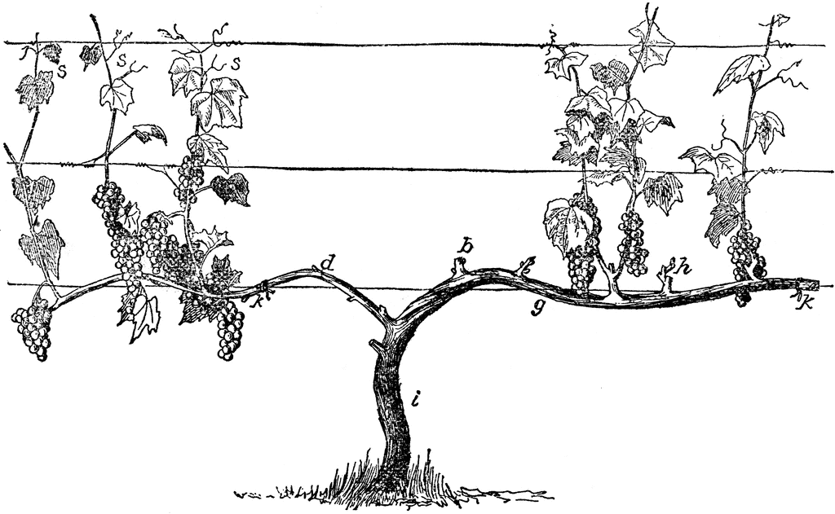
The Secret to Pruning Grapes
Clipart courtesy of FTIC http://etc.usf.edu/clipart

Slide 7
HOW CAN MY LIFE YIELD MORE FRUIT?
by meditating on God’s word (Psalm 1:1-3)
Blessed is the man
who walks not in the counsel of the wicked,
nor stands in the way of sinners,
nor sits in the seat of scoffers;
but his delight is in the law of the Lord,
and on his law he meditates day and night.
He is like a tree
planted by streams of water
that yields its fruit in its season,
and its leaf does not wither.
In all that he does, he prospers. Psalm 1:1-3

Slide 8
HOW CAN MY LIFE YIELD MORE FRUIT?
by dying to myself (John 12:24-26)
Truly, truly, I say to you, unless a grain of wheat falls into the earth and dies, it remains alone; but if it dies, it bears much fruit. Whoever loves his life loses it, and whoever hates his life in this world will keep it for eternal life. If anyone serves me, he must follow me; and where I am, there will my servant be also. If anyone serves me, the Father will honor him. John 12:24-26

Slide 9
HOW CAN MY LIFE YIELD MORE FRUIT?
by being steadfast in the dry seasons of life (Galatians 6:9-10)
And let us not grow weary of doing good, for in due season we will reap, if we do not give up. So then, as we have opportunity, let us do good to everyone, and especially to those who are of the household of faith. Galatians 6:9-10

Slide 10
HOW CAN MY LIFE YIELD MORE FRUIT?
through the prayers of others on my behalf (Colossians 1:9-10)
And so, from the day we heard, we have not ceased to pray for you, asking that you may be filled with the knowledge of his will in all spiritual wisdom and understanding, so as to walk in a manner worthy of the Lord, fully pleasing to him, bearing fruit in every good work and increasing in the knowledge of God. Colossians 1:9-10

Slide 11
HOW CAN MY LIFE YIELD MORE FRUIT?
by focusing my affection on heaven (Hebrews 11:8-12)
By faith Abraham obeyed when he was called to go out to a place that he was to receive as an inheritance. And he went out, not knowing where he was going. By faith he went to live in the land of promise, as in a foreign land, living in tents with Isaac and Jacob, heirs with him of the same promise. For he was looking forward to the city that has foundations, whose designer and builder is God. By faith Sarah herself received power to conceive, even when she was past the age, since she considered him faithful who had promised. Therefore from one man, and him as good as dead, were born descendants as many as the stars of heaven and as many as the innumerable grains of sand by the seashore. Hebrews 11:8-12

Slide 12
WHAT IS A LIFE OF TRUE SIGNIFICANCE?
How do these principles apply to husbands and fathers?
How do they apply to wives and mothers?

Slide 13
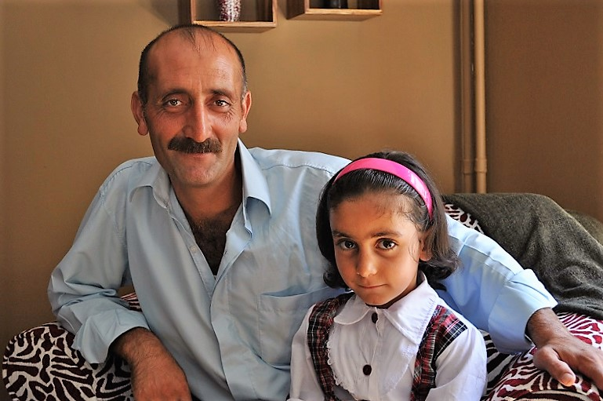
Story of Two Men in Turkey: Sometimes the harvest of our lives is delayed…
1. Jemal

Slide 14
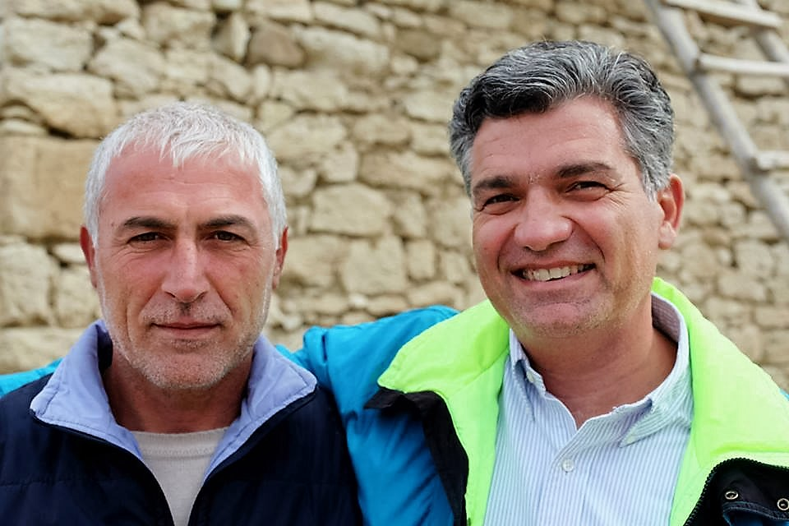
Story of Two Men in Turkey: Sometimes the harvest of our lives is delayed…
2. Haydar

Slide 15
APPLICATION QUESTIONS
Do you have a clear sense of your destiny in life? That is, can you describe what you believe God has in store for you to accomplish before I leave this world? If so, what is it?
Are there any personal dreams or goals you have, which may interfere with God’s purposes for your life? How will you apply this message in taking your steps toward the right direction?
Which of the five ways of bearing more fruit hit home for you? How will you apply it in your everyday life?

