Slide 2
The Bible: The Story of God’s Glory
Missions Month Week #1 Message
Selected Scriptures
© April 3, 2016
Wade Harlan
Notes:
2

Slide 3
WHAT IS THE STORYLINE OF THE BIBLE?
The story of how God brings glory to the Godhead by:
revealing His character
bringing people from every nation, tongue, tribe and place into a intimate, transforming relationship with Him.
In fewer words: “The story of how God brings glory to Himself.”
“Bring my sons from afar and my daughters from the ends of the earth, everyone who is called by my name, whom I created for my glory, whom I formed and made.” Isaiah 43:6-7

Slide 4
GOD’S GLORY - THE STORYLINE OF THE BIBLE
So whether you eat or drink or whatever you do, do it all for the glory of God.
1 Corinthians 10:31
The chief end of man is to glorify God and enjoy him forever. Westminster Shorter Catechism (1646 A.D.)
The chief end of man is to glorify God by enjoying him forever.” John Piper
“God is most glorified in us when we are most satisfied in Him.” John Piper
“And you shall love the Lord your God with all your heart and with all your soul and with all your mind and with all your strength. ‘The second is this: ‘You shall love your neighbor as yourself. ’ There is no other commandment greater than these.” Mark 12:30-31

Slide 5
IF GOD WANTS TO GLORIFY HIMSELF IS HE SELFISH?
Answer: NO! He’s always “other’s centered”—focused on glorifying the other members of the Trinity.
⁹After this I looked, and behold, a great multitude that no one could number, from every nation, from all tribes and peoples and languages, standing before the throne and before the Lamb, clothed in white robes, with palm branches in their hands, ¹⁰and crying out with a loud voice, “Salvation belongs to our God who sits on the throne, and to the Lamb!” ¹¹And all the angels were standing around the throne and around the elders and the four living creatures, and they fell on their faces before the throne and worshiped God, ¹²saying, “Amen! Blessing and glory and wisdom and thanksgiving and honor and power and might be to our God forever and ever! Amen.” Revelation 7:9-12

Slide 6
IF GOD WANTS TO GLORIFY HIMSELF IS HE SELFISH?
Answer: NO! He’s always “other’s centered”—focused on glorifying the other members of the Trinity.
²⁴Then comes the end, when he delivers the kingdom to God the Father after destroying every rule and every authority and power. ²⁵For he must reign until he has put all his enemies under his feet. ²⁶The last enemy to be destroyed is death. ²⁷For “God has put all things in subjection under his feet.” But when it says, “all things are put in subjection,” it is plain that he is excepted who put all things in subjection under him. ²⁸When all things are subjected to him, then the Son himself will also be subjected to him who put all things in subjection under him, that God may be all in all.” 1 Corinthians 15: 24-28

Slide 7
GOD’S HEART FOR ALL PEOPLES SEEN IN THE MAJOR EVENTS OF THE OLD TESTAMENT
Creation – Gen 1:28 “Be fruitful, and increase in number; fill the earth and subdue it.”
Fall of Man - Gen 3:15 “He will crush your head and you will strike His heel.”
Flood - Gen 6:5-9, 9:1 “Be fruitful, and increase in number and fill the earth.”
Babel - Gen 11:1-9 “Let us build ourselves a city ... and make a name for ourselves and not be scattered..”
Nations - Gen 10 - 70 names/nations are listed

Slide 8
GOD’S HEART FOR ALL PEOPLES SEEN IN THE MAJOR EVENTS OF THE OLD TESTAMENT
Abrahamic Covenant
“… and all peoples on earth will be blessed through you.” – Gen 12: 1-3
“The scripture foresaw the God would justify the Gentiles by faith and announced the gospel in advance to Abraham: “All nations will be blessed through you.” – Gal. 3:6-9
10 Plagues and the Passover
“I have raised you up for this very purpose that I might show you my power and that my name might be proclaimed in all the earth.” – Ex 9:16, 20,26 Ex 12:37-38
Red Sea Josh 2:8-11
Mt. Sinai & The Law - Dt 4:5-8, Leviticus 19:33,34
12 Spies & The Wilderness Wanderings - 40 years in the desert

Slide 9
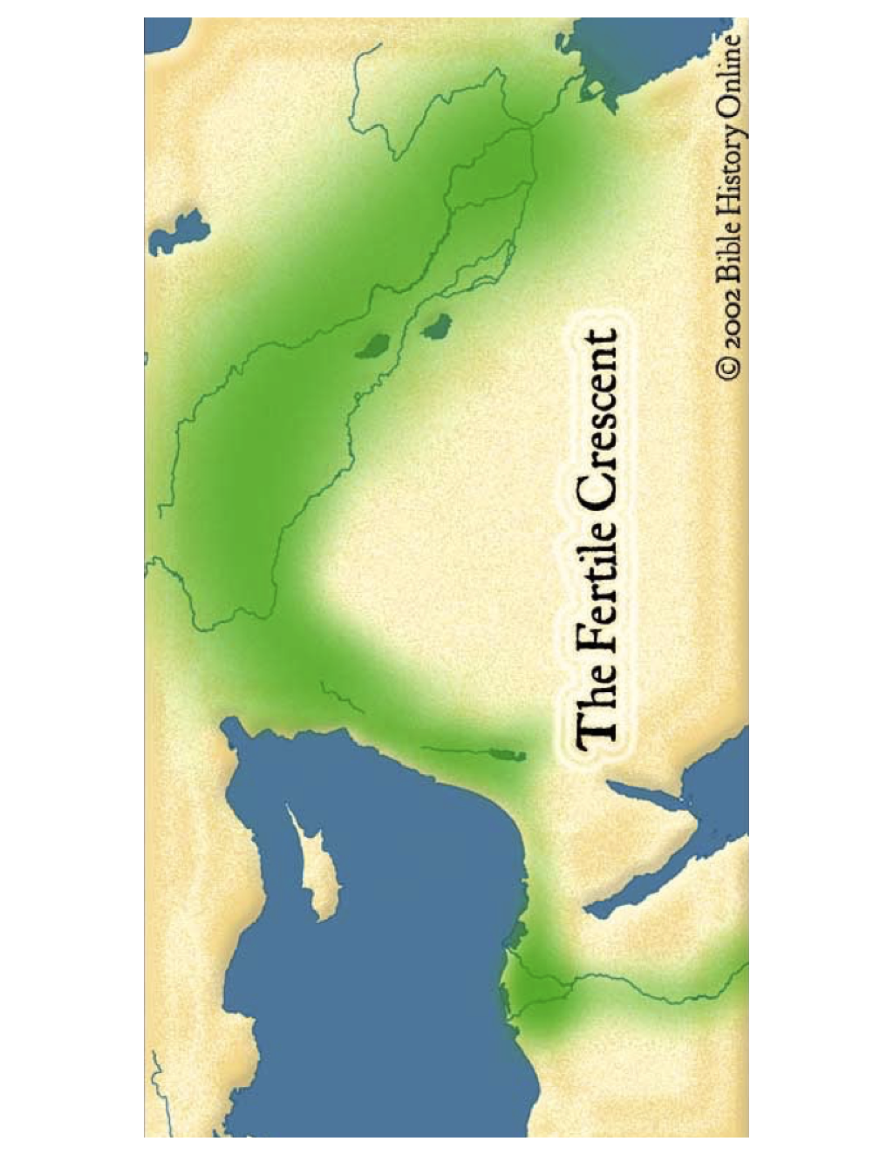
GOD’S HEART FOR ALL PEOPLES SEEN IN THE MAJOR EVENTS OF THE OLD TESTAMENT
Taking the Promised Land - Eze. 5:5 “This is Jerusalem which I have set in the center of the nations.”

Slide 10
GOD’S HEART FOR ALL PEOPLES SEEN IN THE MAJOR EVENTS OF THE OLD TESTAMENT
Period of the Judges - Judges 21:25: “Everyone did as he saw fit” Ruth -the Moabite
United Kingdom
Saul - No Heart
David - Whole Heart 1 Samuel 17:45 Ps 67, Ps. 22,
Solomon - Half Heart 1 Kings 8:41-43, 1 Ki 10 - Queen Sheba

Slide 11
GOD’S HEART FOR ALL PEOPLES SEEN IN THE MAJOR EVENTS OF THE OLD TESTAMENT
Divided Kingdom - 1 Ki 17:7-24 widow, 2 Ki 5:2,3, 15 Naaman the Syrian
North / South
Israel /Judah (name)
Samaria/ Jerusalem (capital cities)
19/20 (# of kings)
0/8 (good kings)
A - Assyrian Exile - Isaiah 49:6
B - Babylonian Captivity - Dan 2:46,47 (Nebuchadnezzar) Dan 3:29 (Nebuchadnezzar) Dan 6:25-27 (Darius)
C- Cyrus allows The Return - Esther 8:15-17
Zerubabel temple
Ezra people
Nehemiah walls

Slide 12
WHAT IS THE STORYLINE OF THE BIBLE?
The story of how God brings glory to the Godhead by:
revealing His character
bringing people from every nation, tongue, tribe and place into a intimate, transforming relationship with Him.
In fewer words: “The story of how God brings glory to Himself.”
It’s God’s eternal purpose, not something just at the end of Jesus life.
How much is our life in line with God’s eternal purpose?
Because it’s God’s eternal purpose we all must be involved.
How is God calling you to glorify Him?

Slide 13
RESOURCES
Books: Unveiled at Last (Bob Sjogren)
Let The Nations Be Glad (John Piper)
Yes, God of the Gentiles, Too (David Filbeck)
Novels: Hastenings (Steve Smith)
Hastenings Part 2 ( Steve Smith) May 2016

Slide 14
THREE PRACTICAL QUESTIONS FOR OUR EVERYDAY LIFE
In what way(s) has today changed your view or understanding of God or the Bible?
How much of your life in line with God’s eternal purpose?
What do you want to do differently in your life because of what was shared today?

