Slide 2
Mission: Not Complete
Missions Awareness Month Series, Part 3
Selected Scriptures
March 16, 2014
Guest Speaker: John Lambert
Notes:
2

Slide 3
The Book of the Mission of God
From beginning to end, the whole Bible is the basis of mission, not just a few verses.
“I will put enmity between you and the woman, and between your offspring and her offspring; he shall bruise your head, and you shall bruise his heel.” Genesis 3:15

Slide 4
The Book of the Mission of God
From beginning to end, the whole Bible is the basis of mission, not just a few verses.
¹ Now the Lord said to Abram, “Go from your country and your kindred and your father's house to the land that I will show you. ² And I will make of you a great nation, and I will bless you and make your name great, so that you will be a blessing. ³ I will bless those who bless you, and him who dishonors you I will curse, and in you all the families of the earth shall be blessed.” Genesis 12:1-3

Slide 5
The Book of the Mission of God
From beginning to end, the whole Bible is the basis of mission, not just a few verses.
he says: “It is too light a thing that you should be my servant to raise up the tribes of Jacob and to bring back the preserved of Israel; will make you as a light for the nations, that my salvation may reach to the end of the earth.” Isaiah 49:6

Slide 6
Infinite Worth & Absolute Supremacy
Without the right view of the King and his Kingdom mission doesn’t make sense.
“The kingdom of heaven is like treasure hidden in a field, which a man found and covered up. Then in his joy he goes and sells all that he has and buys that field.”
Matthew 13:44

Slide 7
Infinite Worth & Absolute Supremacy
Without the right view of the King and his Kingdom mission doesn’t make sense.
for it is written,
“As I live, says the Lord, every knee shall bow to me, and every tongue shall confess to God.” Romans 14:11

Slide 8
Infinite Worth & Absolute Supremacy
Without the right view of the King and his Kingdom mission doesn’t make sense.
And he was teaching them and saying to them, “Is it not written, ‘My house shall be called a house of prayer for all the nations’? But you have made it a den of robbers.”
Mark 11:17

Slide 9
Everyone on Mission
No believer is exempt from living on mission with God.
¹⁸ And Jesus came and said to them, “All authority in heaven and on earth has been given to me. ¹⁹ Go therefore and make disciples of all nations, baptizing them in the name of the Father and of the Son and of the Holy Spirit, ²⁰ teaching them to observe all that I have commanded you. And behold, I am with you always, to the end of the age.”
Matthew 28:18-20

Slide 10
Everyone on Mission
No believer is exempt from living on mission with God.
¹⁸ All this is from God, who through Christ reconciled us to himself and gave us the ministry of reconciliation; ¹⁹ that is, in Christ God was reconciling the world to himself, not counting their trespasses against them, and entrusting to us the message of reconciliation. ²⁰ Therefore, we are ambassadors for Christ, God making his appeal through us. We implore you on behalf of Christ, be reconciled to God. ²¹ For our sake he made him to be sin who knew no sin, so that in him we might become the righteousness of God.
2 Corinthians 5:18-21

Slide 11
Everyone on Mission
No believer is exempt from living on mission with God.
¹¹ And he gave the apostles, the prophets, the evangelists, the shepherds and teachers, ¹² to equip the saints for the work of ministry, for building up the body of Christ.
Ephesians 4:11-12

Slide 12
Crossing Cultures
Unreached people: Those with little to no access to the Gospel. Their population is less than 2 % evangelical or less than 5% Christian of any kind.

Slide 14
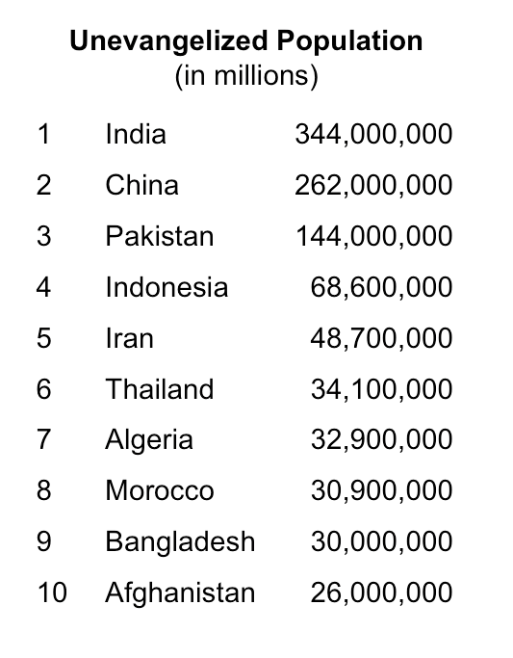

Slide 15
Crossing Cultures
Unreached people: Those with little to no access to the Gospel. Their population is less than 2 % evangelical or less than 5% Christian of any kind.
³⁵ Do you not say, ‘There are yet four months, then comes the harvest’? Look, I tell you, lift up your eyes, and see that the fields are white for harvest. ³⁶ Already the one who reaps is receiving wages and gathering fruit for eternal life, so that sower and reaper may rejoice together. ³⁷ For here the saying holds true, ‘One sows and another reaps.’ ³⁸ I sent you to reap that for which you did not labor. Others have labored, and you have entered into their labor.”
John 4:35-38

Slide 16
Crossing Cultures
Unreached people: Those with little to no access to the Gospel. Their population is less than 2 % evangelical or less than 5% Christian of any kind.
and thus I make it my ambition to preach the gospel, not where Christ has already been named, lest I build on someone else's foundation. Romans 15:20

Slide 17
Crossing Cultures
Unreached people: Those with little to no access to the Gospel. Their population is less than 2 % evangelical or less than 5% Christian of any kind.
¹⁹ For though I am free from all, I have made myself a servant to all, that I might win more of them. ²⁰ To the Jews I became as a Jew, in order to win Jews. To those under the law I became as one under the law (though not being myself under the law) that I might win those under the law. ²¹ To those outside the law I became as one outside the law (not being outside the law of God but under the law of Christ) that I might win those outside the law. ²² To the weak I became weak, that I might win the weak. I have become all things to all people, that by all means I might save some. ²³ I do it all for the sake of the gospel, that I may share with them in its blessings.
1 Corinthians 9:19-23

Slide 18
Mission: Not Complete
We have never had more potential resources to complete the mission. What we don’t have is the focus.
And this gospel of the kingdom will be proclaimed throughout the whole world as a testimony to all nations, and then the end will come.
Matt 24:14

Slide 19
Mission: Not Complete
We have never had more potential resources to complete the mission. What we don’t have is the focus.
And they sang a new song, saying, “Worthy are you to take the scroll and to open its seals, for you were slain, and by your blood you ransomed people for God from every tribe and
language and people and nation.” Revelation 5:9

Slide 20
Mission: Not Complete
We have never had more potential resources to complete the mission. What we don’t have is the focus.
After this I looked, and behold, a great multitude that no one could number, from every nation, from all tribes and peoples and languages, standing before the throne and before the Lamb, clothed in white robes, with palm branches in their hands. Revelation 7:9

Slide 21
Mission: Not Complete
We have never had more potential resources to complete the mission. What we don’t have is the focus.
waiting for and hastening the coming of the day of God, because of which the heavens will be set on fire and dissolved, and the heavenly bodies will melt as they burn! 2 Peter 3:12

Slide 22
The Great Imbalance
The 10/40 window is home to the main unreached peoples: Some of the world’s “poorest of the poor”, greatest persecution, worst injustice.

Slide 23
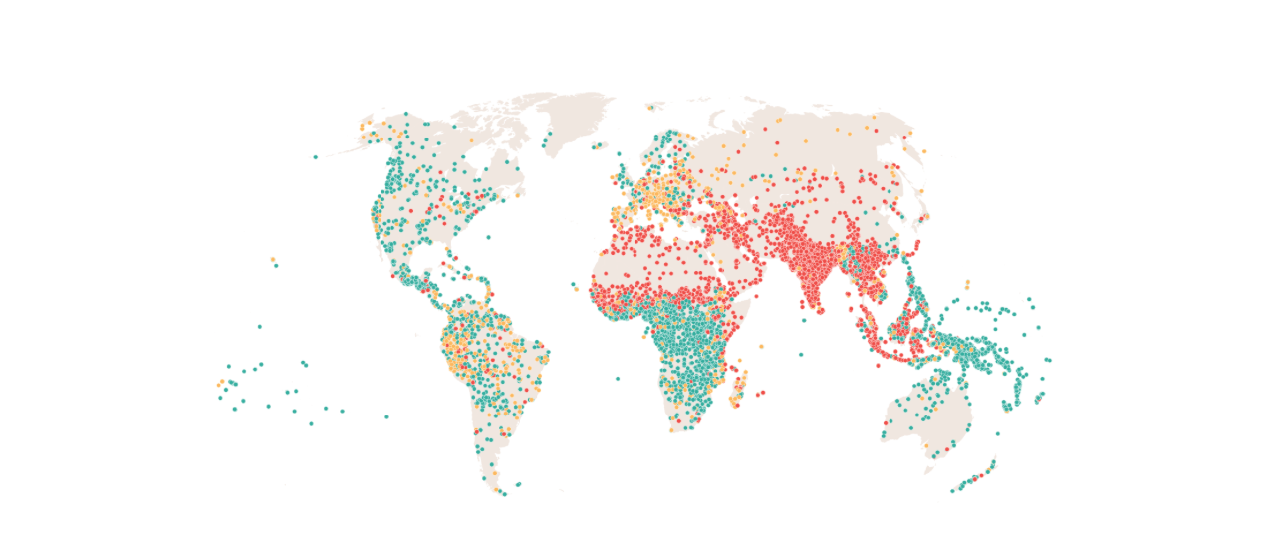

Slide 24
The Great Imbalance
The 10/40 window is home to the main unreached peoples: Some of the world’s “poorest of the poor”, greatest persecution, worst injustice.
THUMB: Tribals, Hindus, Unreligious, Muslims, Buddhists.
“86% of Muslims, Hindus, and Buddhists don’t know a Christian friend.” — Todd Johnson, PhD., Center for the Study of Global Christianity
Only 2 out of every 10 missionaries serve among the unreached people groups.
Only $1 out of $100 sent to the mission field goes to the unreached peoples.

Slide 26
Forward Together!
God wants YOU spiritually whole, and moving forward with him so you can be a blessing…even to the ends of the earth. (Acts 1:8-9)
Know. Pray. Give. Go. Welcome. Mobilize.
The time is short…the King is coming…we are to look forward to and hasten the day of his coming.
May we be found faithful when he comes!
John Lambert
@johnlambert
www.spreadtheflame.com
www.uscwm.org/lambert

Slide 27
THREE PRACTICAL QUESTIONS FOR OUR EVERYDAY LIFE
What one thing hit home for you more than anything from this message? Why?
In what way are you now more convinced about the importance and urgency of reaching the unreached people of the world?
What might be your first step toward the six-fold challenge for unreached people: (1) Know, (2) Pray, (3) Give, (4) Go, (5) Welcome, and (6) Mobilize?

